Slide 1
Life Engine Creating artificial life for scientific and entertainment purposes
8th AquaDEB meeting
CAMARET-SUR-MER, DEC 1 -3
G. M. Marques
Instituto Superior Técnico,
goncalo.marques@ist.utl.pt
December 1-3, 2010

Slide 2
State of the Art in Videogames
2
Engines
Physics (Little Big Planet)
Natural Motion
December 1-3, 2010
Notes:
2

Slide 3
Generalized DEB model
3
Examples of building blocks:
December 1-3, 2010
Notes:
3

Slide 4
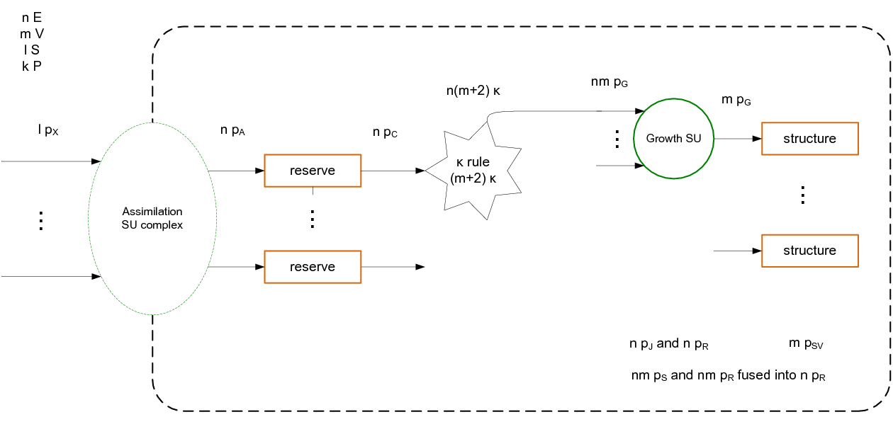
Generalized DEB model
4
One Module
December 1-3, 2010
Notes:
4

Slide 5
Generalized DEB model
5
Examples of 3 important problems:
When to reproduce in a real time simulation? (Are we there yet, are we there yet,... problem)
Maturity stochiometry (The stochiometry of information)
Catabolic power in a multiple structure DEB organism
December 1-3, 2010
Notes:
5

Slide 6
Construction of a Generalized DEB model
6
Define
Number of modules and type of translocation (Plant has two modules – Root and Shoot)
Number of state variables by type in a module (This defines the number of parameters by type)
Values of the parameters
Initial values of the state variables
... and we’re set to go.
December 1-3, 2010
Notes:
6

Slide 7
Data model
7
December 1-3, 2010
Notes:
7

Slide 8
Levels
8
Levels
Ecosystem (contains one community, one food web, compounds, environmental variables)
Community (contains populations, and is responsible for regulating interspecies interactions)
Population (contains organisms, and is responsible for regulating intraspecies interactions)
Organism (contains state variables)
Food web (contains arcs and nodes, which link all substrates that can be compounds, organisms, or specific state variables)
Compound (accounts for non-living substrates. It can have internal dynamics)
Environmental variable
December 1-3, 2010
Notes:
8

Slide 9
Organism
9
December 1-3, 2010
Notes:
9

Slide 10
State Variables and Fluxes
10
Let us take a look at the interconnectivity between state varaiables and fluxes in a case of the standard DEB model.
December 1-3, 2010
Notes:
10

Slide 11
State Variables and Fluxes
11
December 1-3, 2010
Notes:
11

Slide 12
State Variables and Fluxes
12
December 1-3, 2010
Notes:
12

Slide 13
State Variables and Fluxes
13
December 1-3, 2010
Notes:
13

Slide 14
State Variables and Fluxes
14
We need to build a web of state variables and fluxes (nodes).
And the fluxes can be divided in two big groups: supply and demand.
December 1-3, 2010
Notes:
14

Slide 15
Features
15
With this data model we will be able to simulate:
Organism 1 to several reserves 1 to several structures reproduction buffer or not maturity or not 0 or several products ageing state variables or not
Population can include organisms of one species but with different models
December 1-3, 2010
Notes:
15

Slide 16
Unnacounted Features
16
There is still the need to add the some features that are already or are becoming standard in DEB theory:
Toxicity Add a new type of state variable to account for the storage of a toxic compound, and add new fluxes to account for toxic compound handling
Isotopes Add a variable for each state variable with mass that accounts for the fraction of a given isotope, and add the needed parameters
We would welcome more suggestions.
Especially suggestions of features that you feel should be included first!
December 1-3, 2010
Notes:
16

