Slide 1
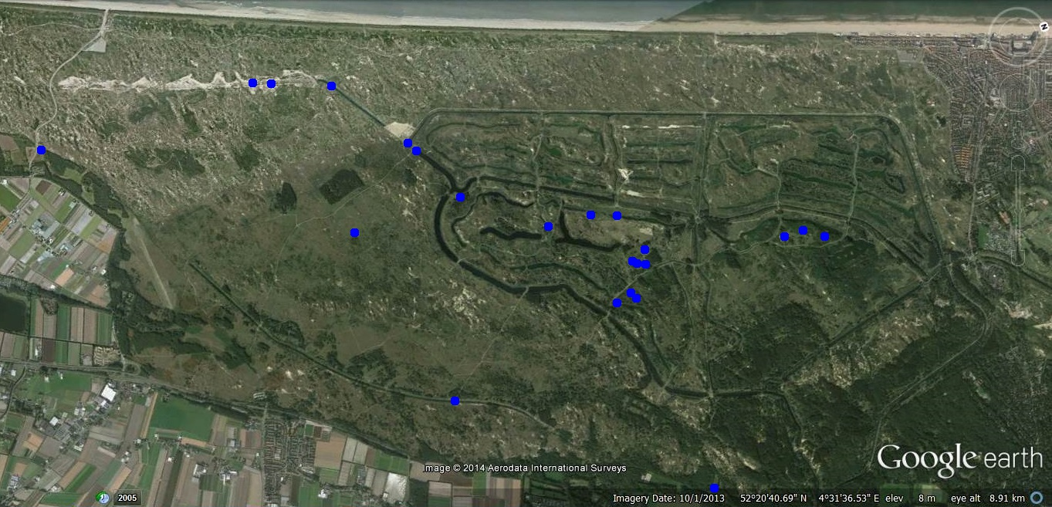
Poelen in the ADW
2017/11/09/20:35-20:45
Dorpshuis Vogelenzang
Bas Kooijman: microleven

Slide 2
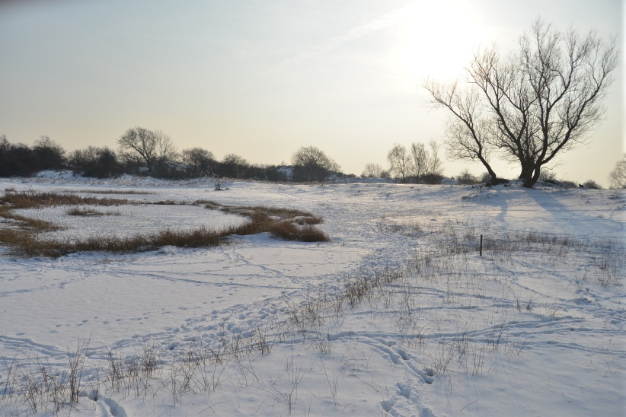
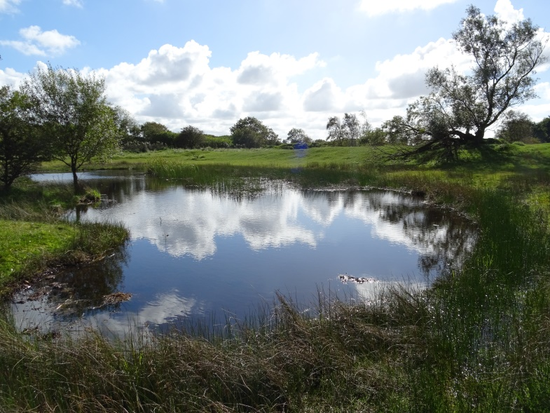
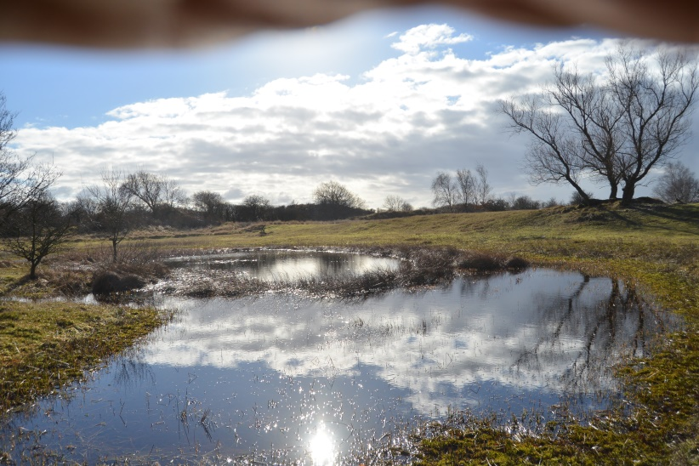
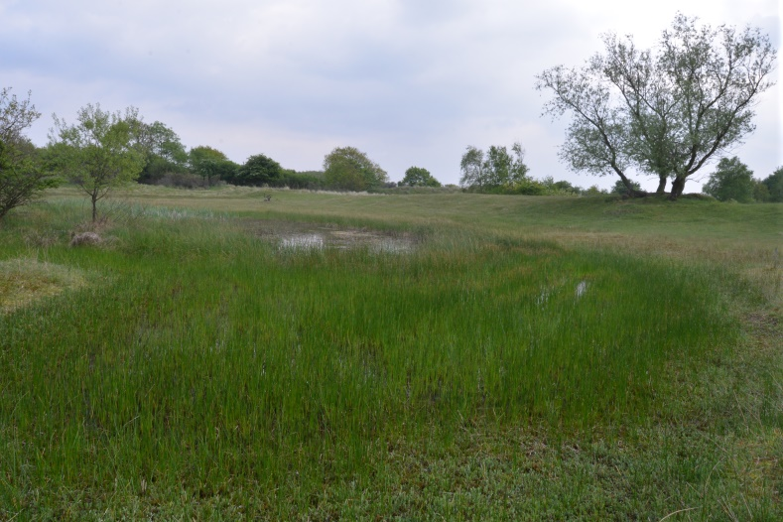
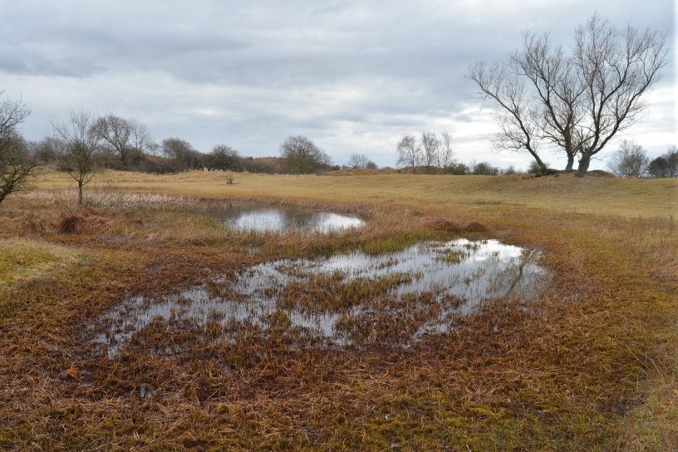
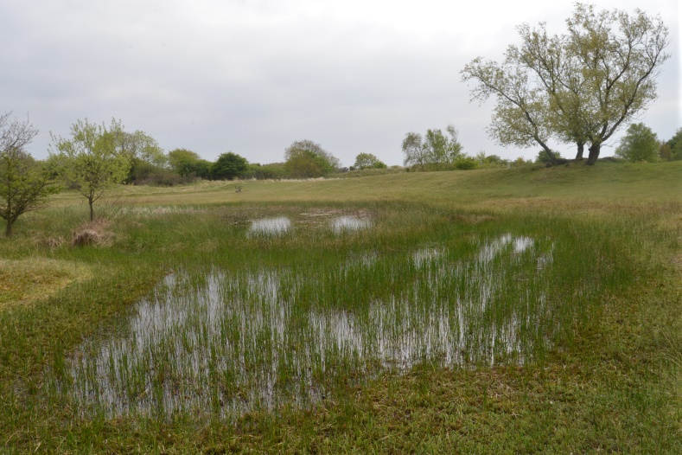
2013/01/25
Na
uitdieping
2015/09/25
2013/02/08
2013/05/30
2013/04/12
2013/05/19

Slide 3
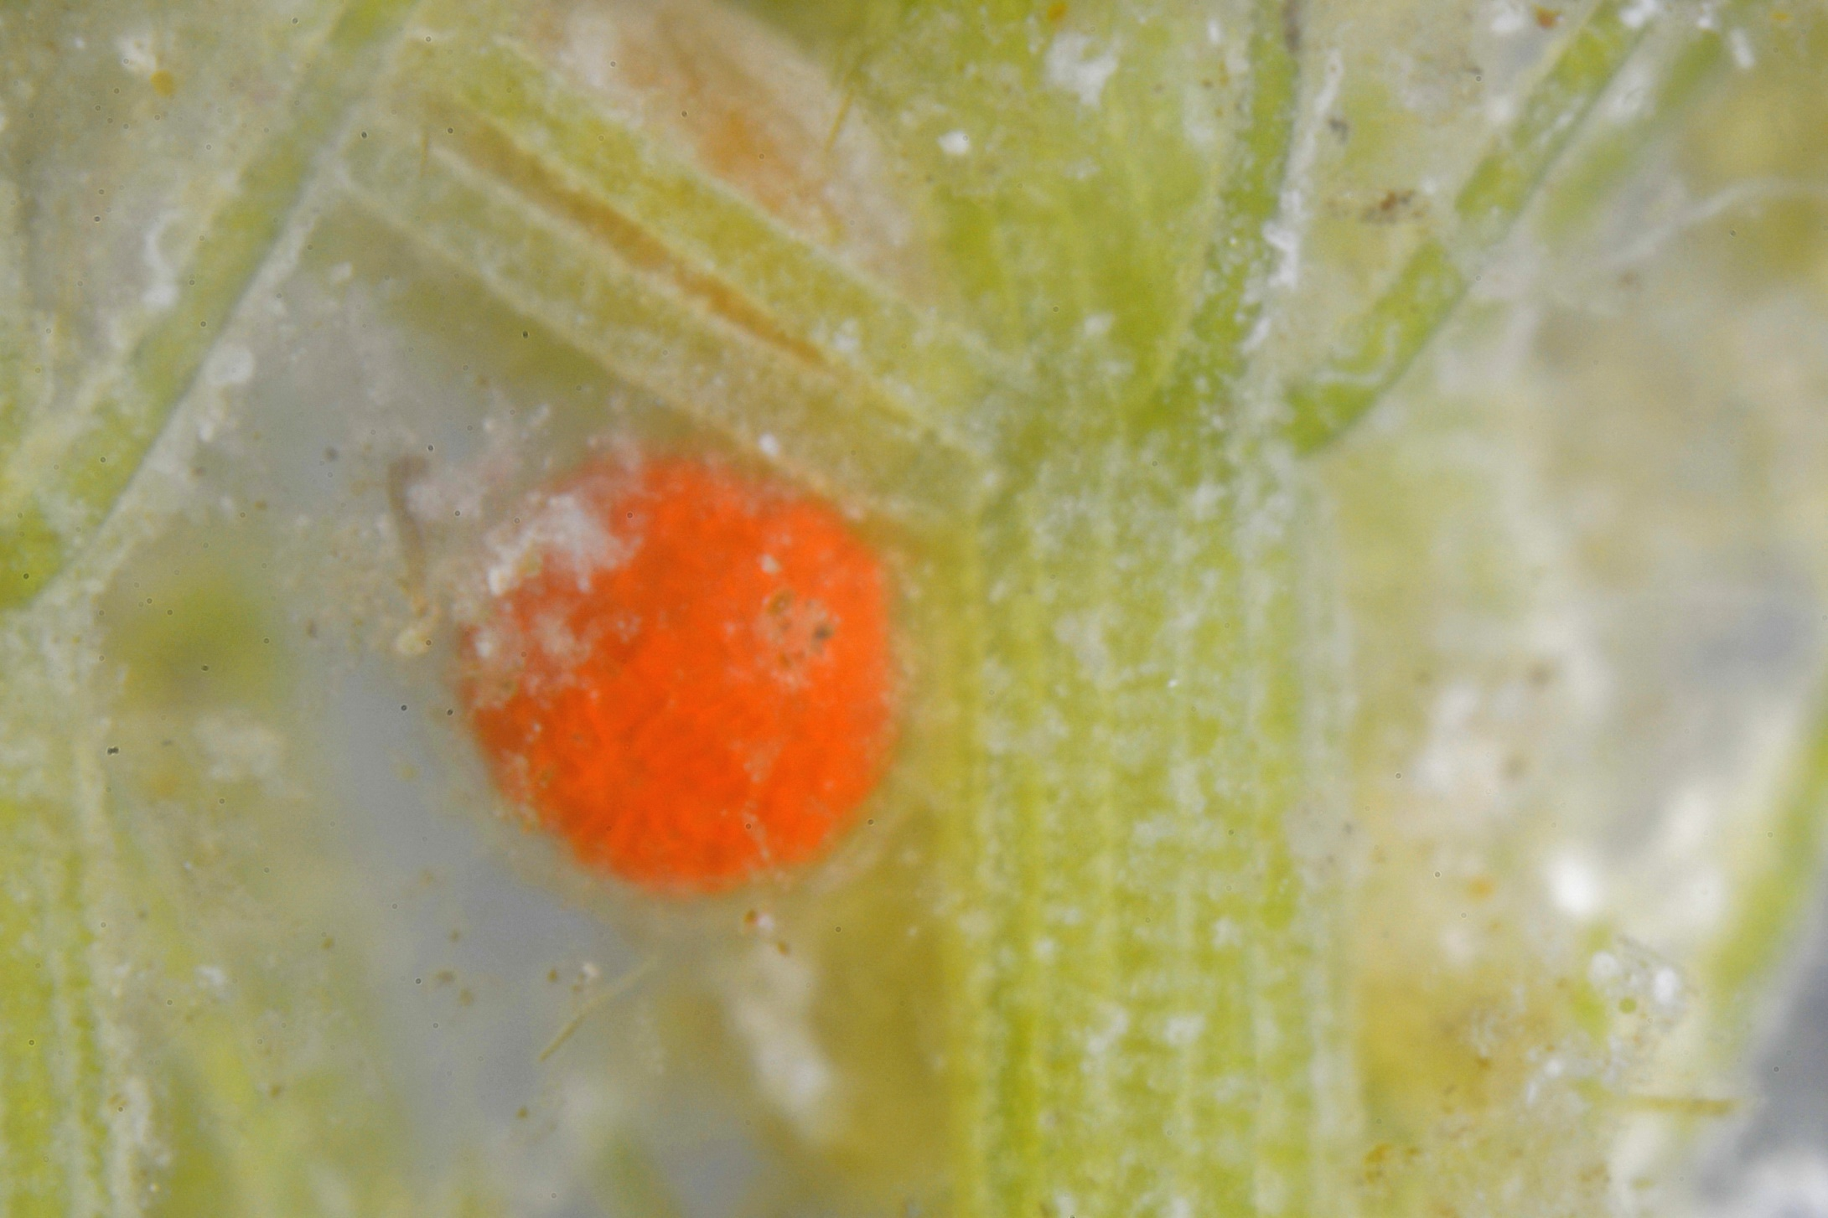
Chara major, kranswier

Slide 4
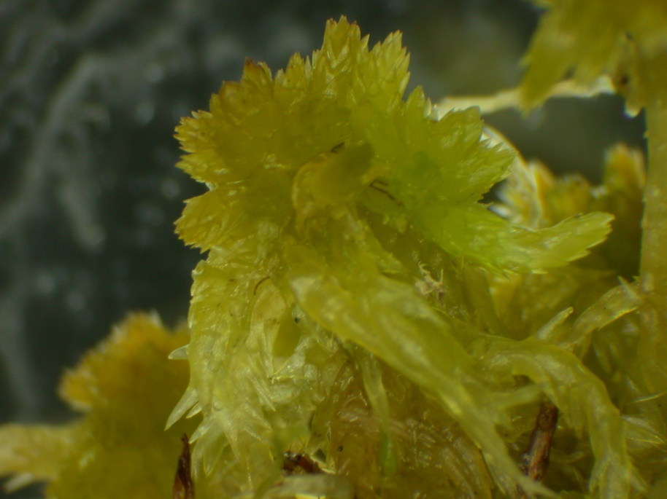
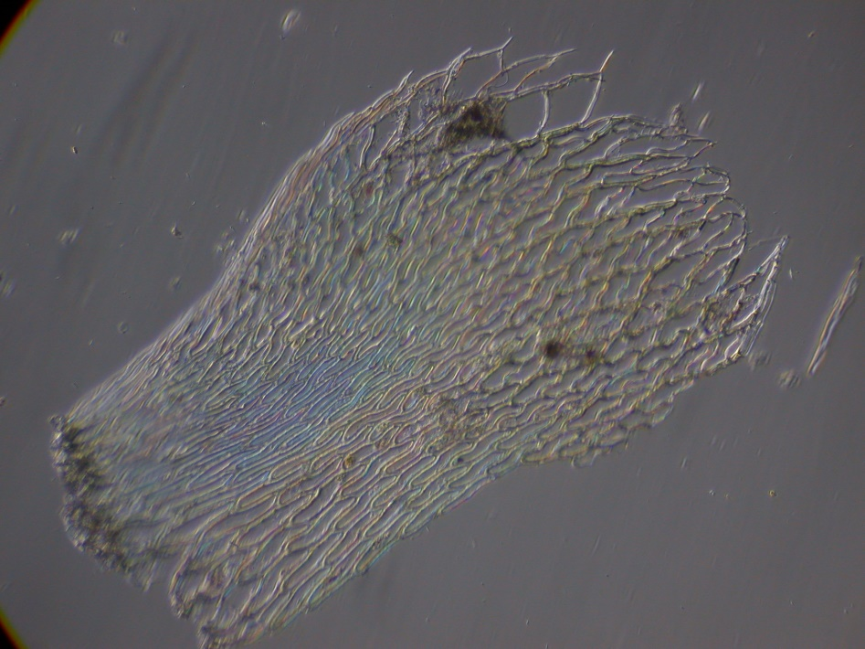
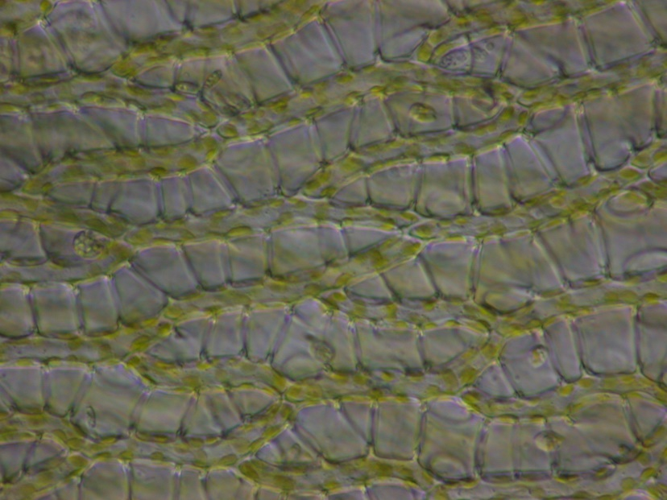
Sphagnum fimbriatum
Veenmos

Slide 5
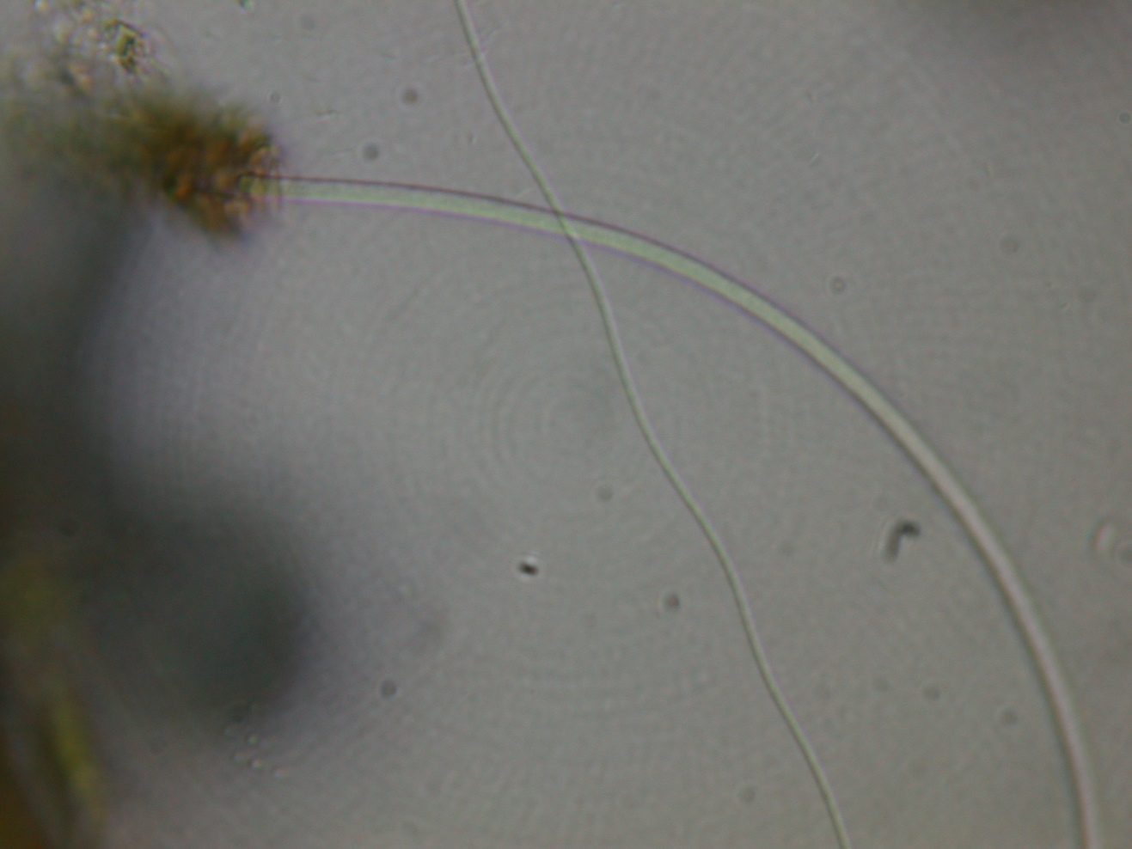
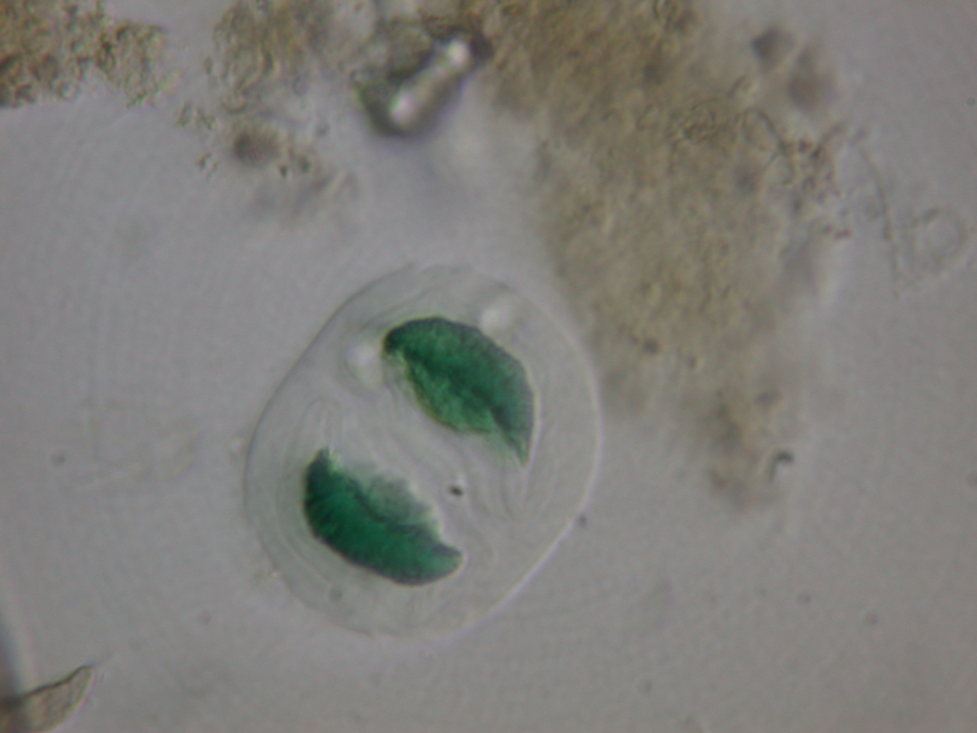
Bacteria
Siderocapsa quadrata
Actinobacteria
Vitreoscilla_beggiatoides
Proteobacteria

Slide 6
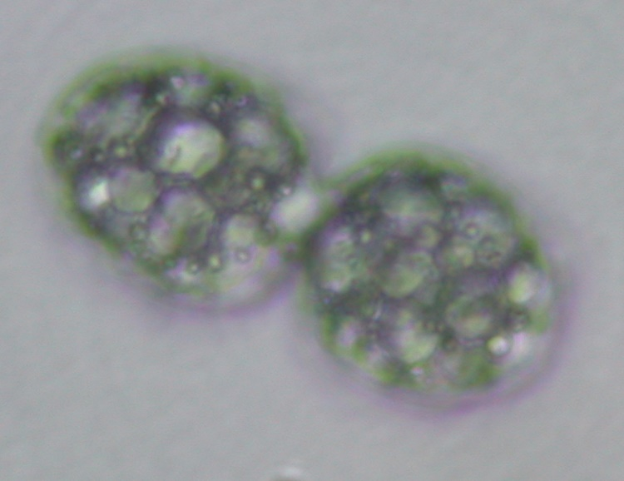
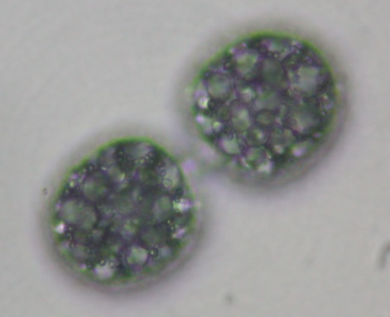
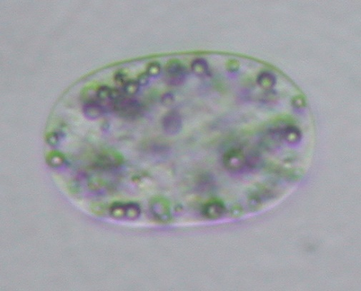
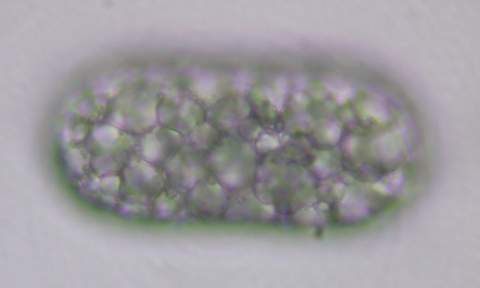
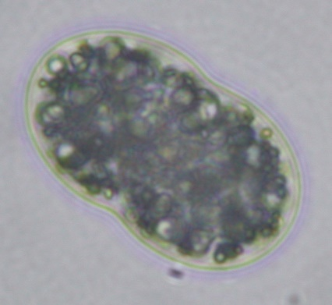
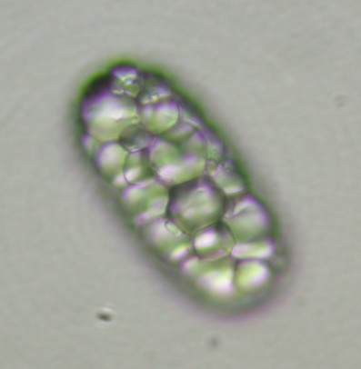
Bacteria
Achromatium oxaliferum, Proteobacteria

Slide 7
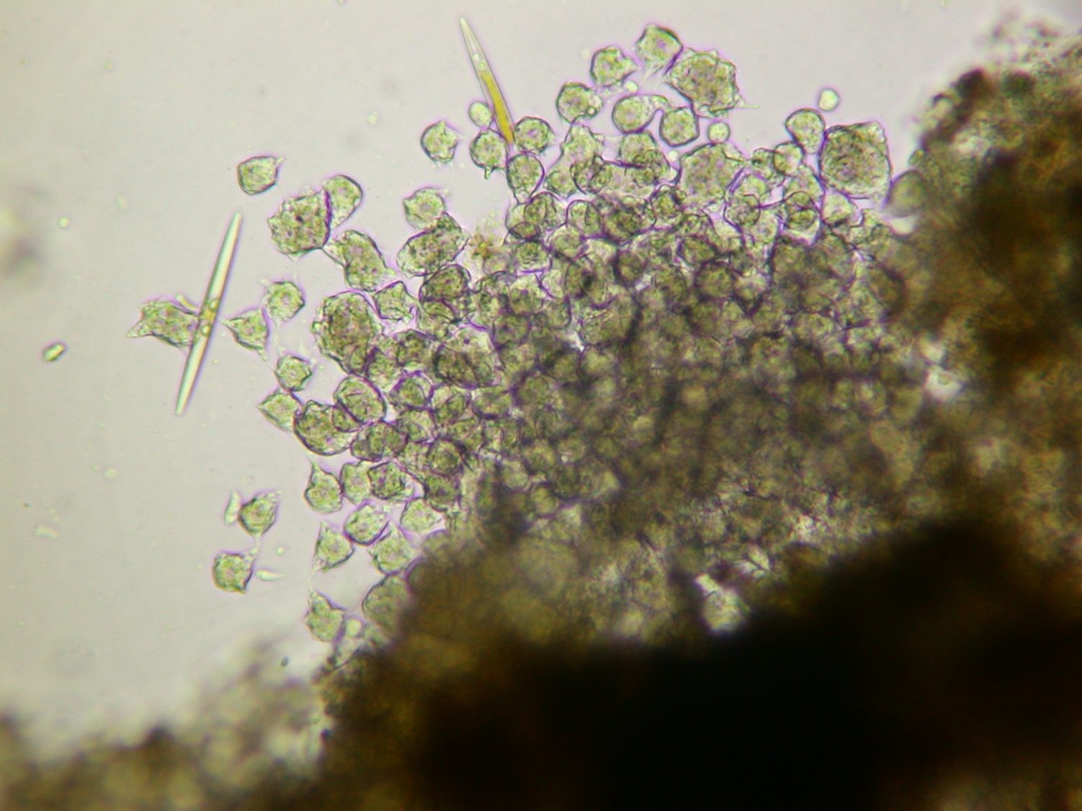
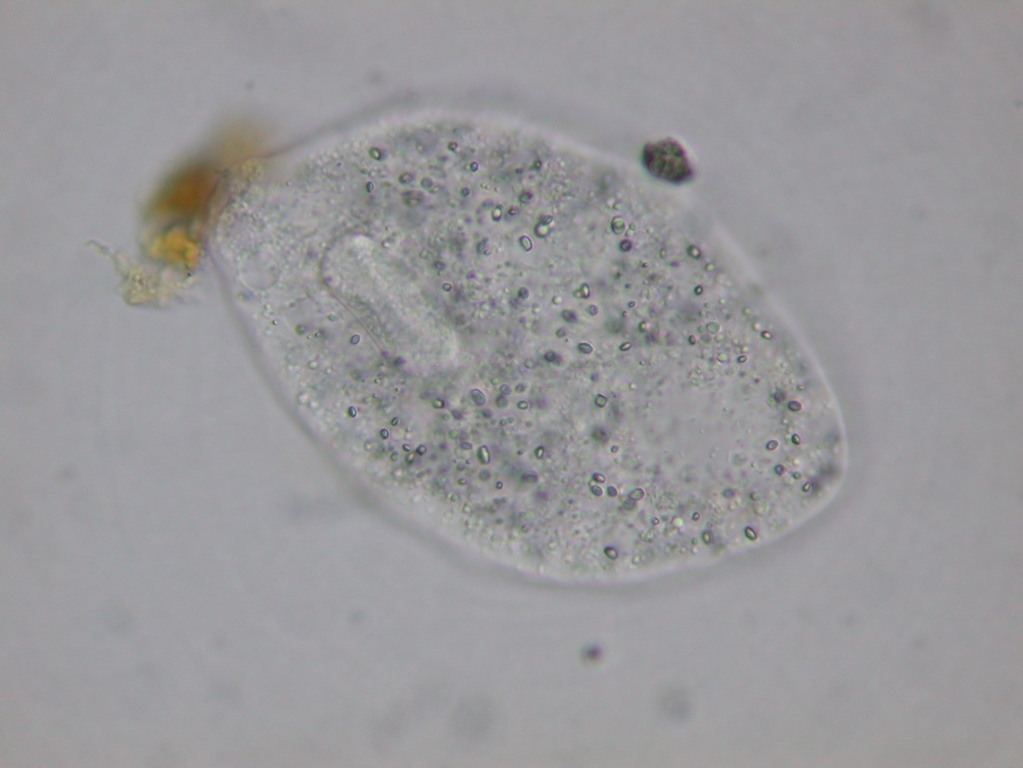
Amoeba
Pelomyxa palustris

Slide 8
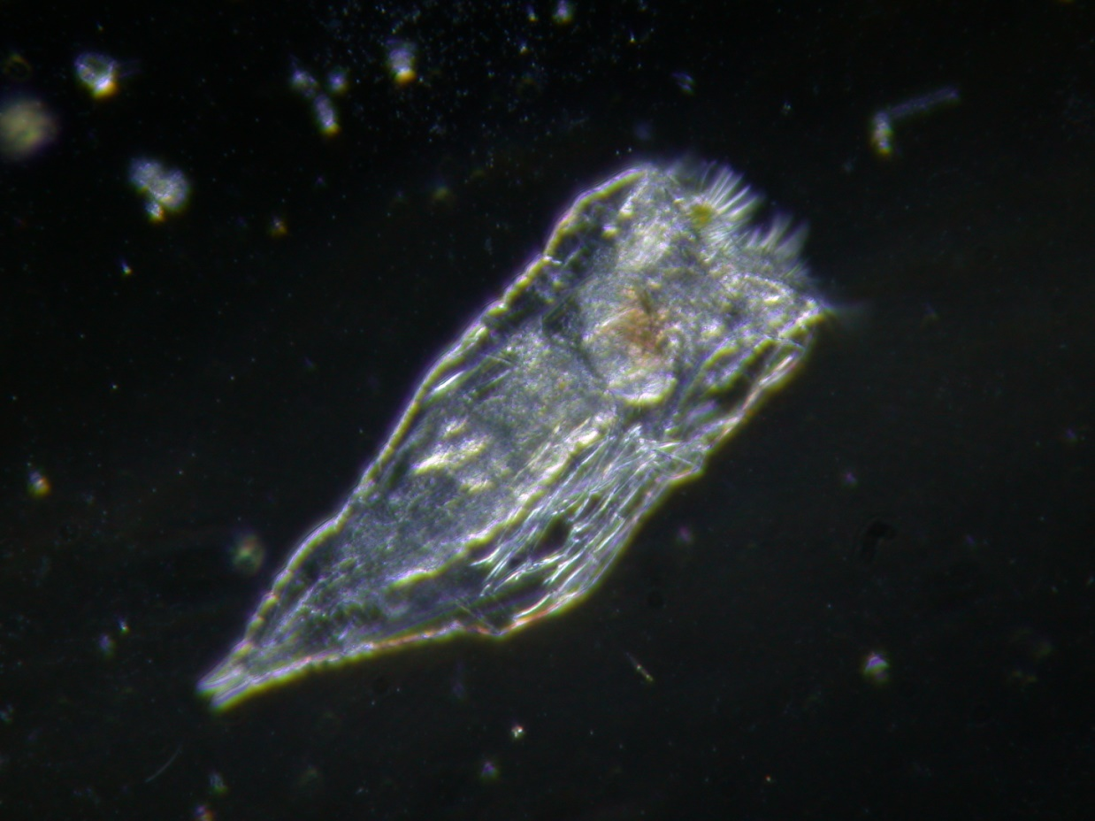
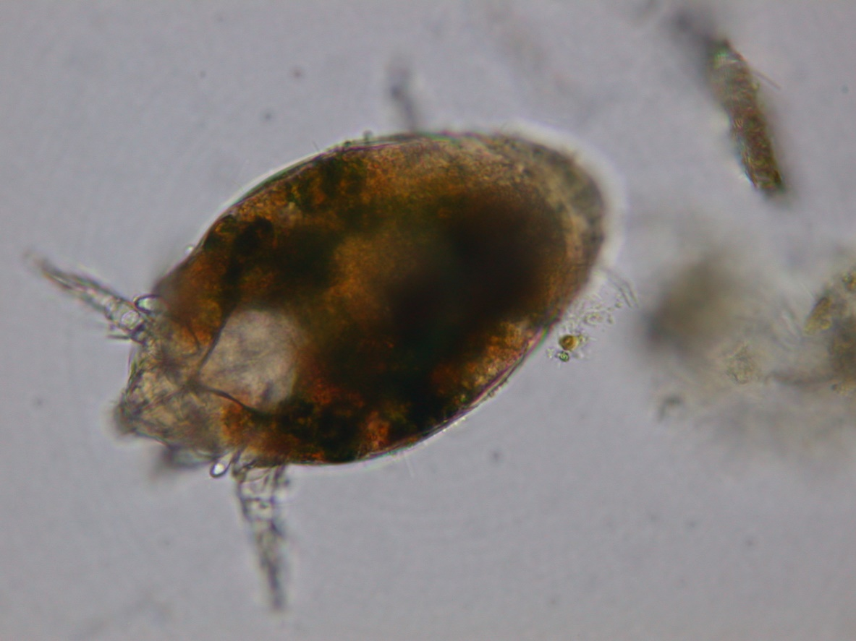
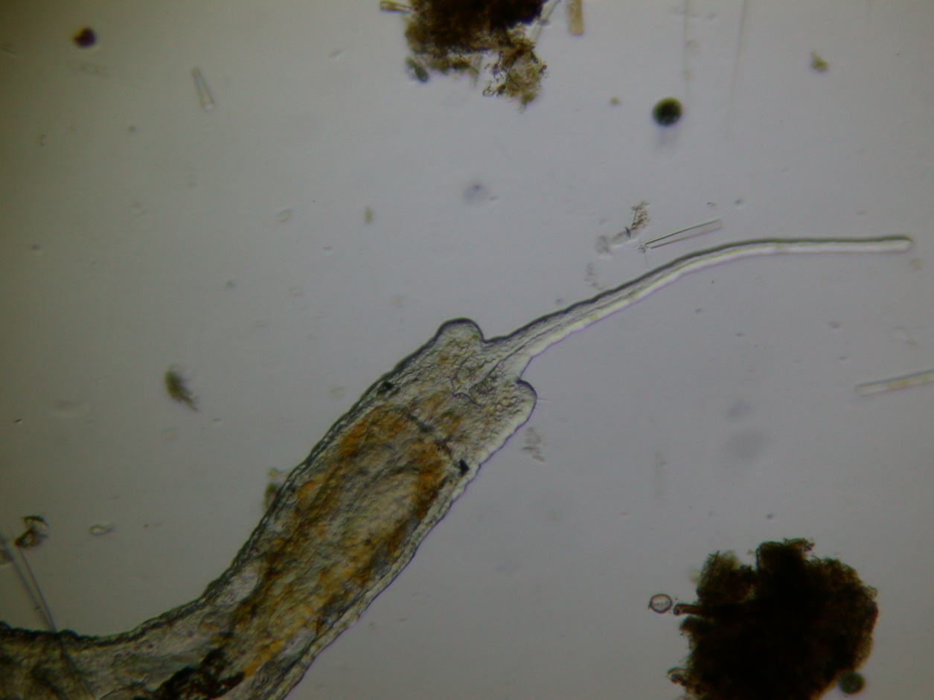
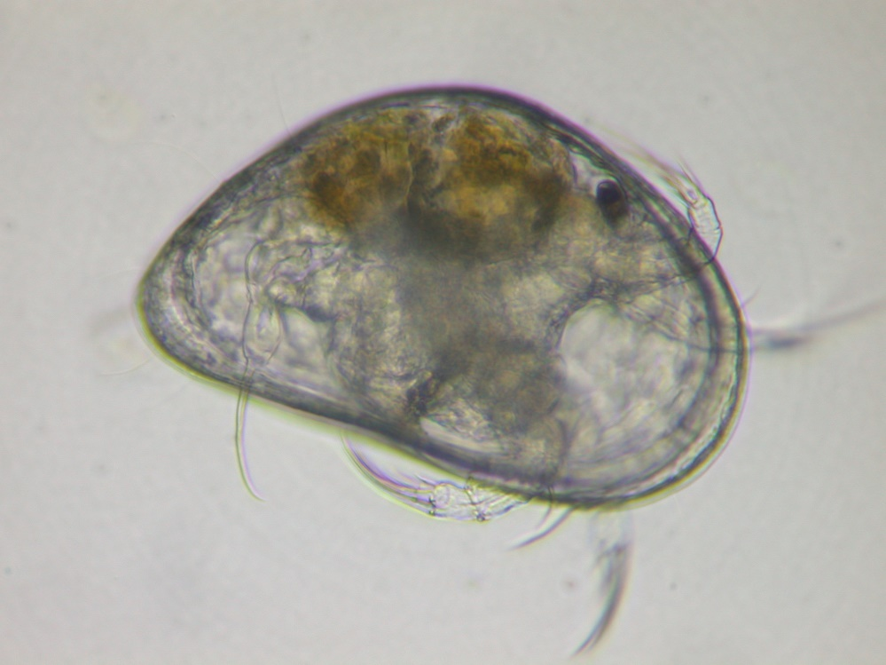
Proales_daphnicola,
Rotifera
Animalia
Schwiebea, Acari
Stylaria_lacustris,
Analida
Potamocypris_smaragdina,
Ostracoda

Slide 9
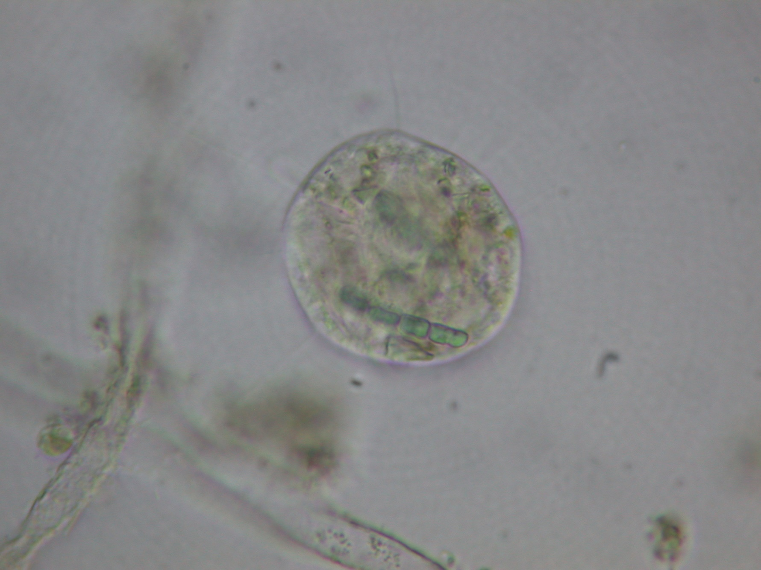
Cercozoa
Vampyrella

Slide 10
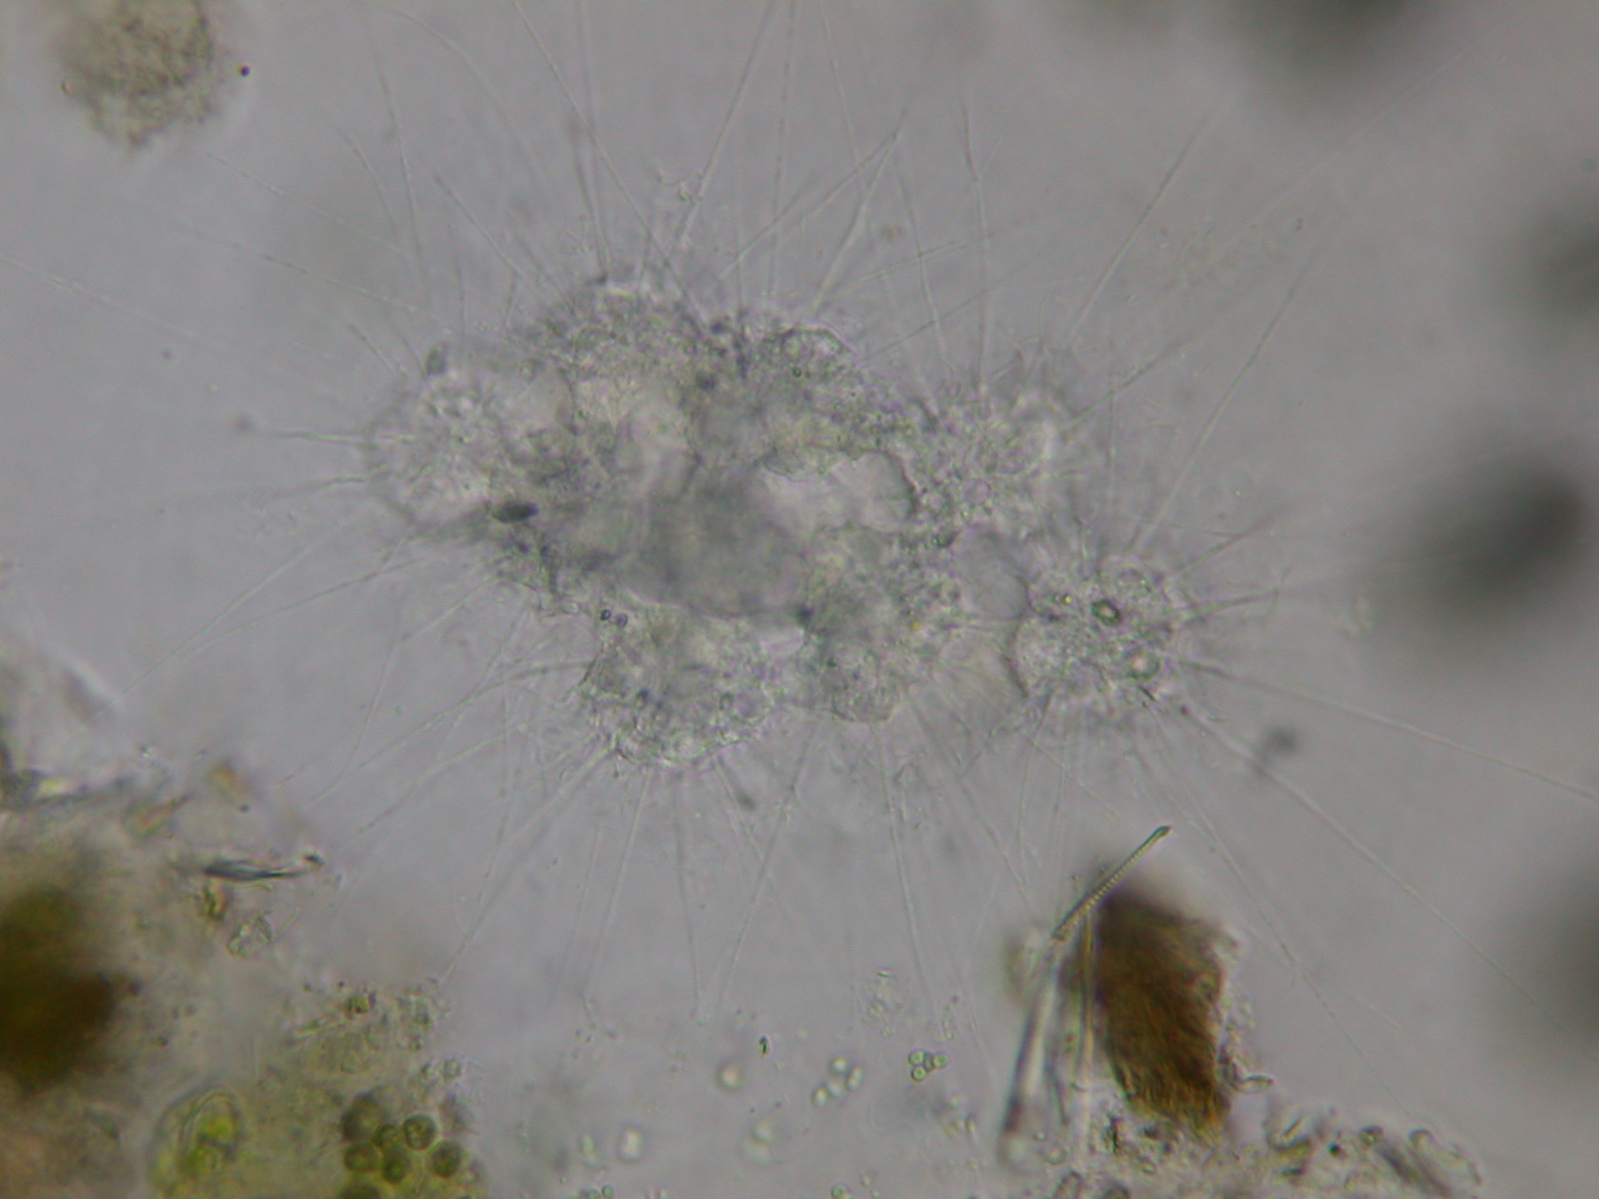
Heliozoa
Raphidiophrys elegans

Slide 11
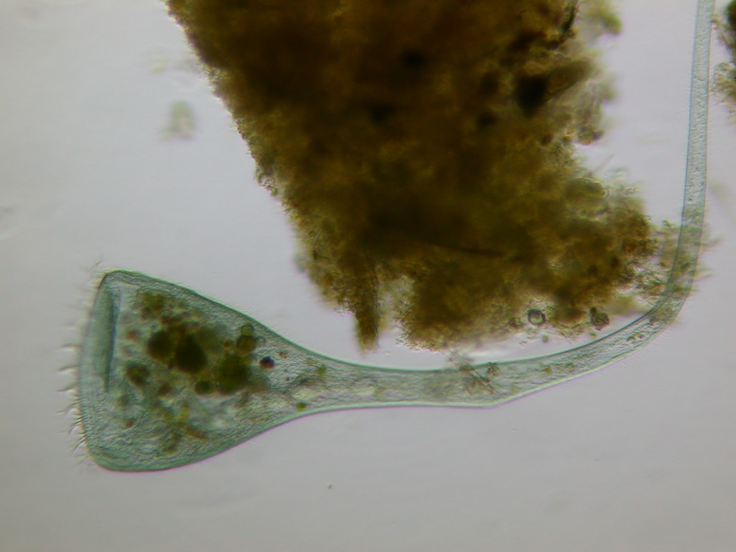
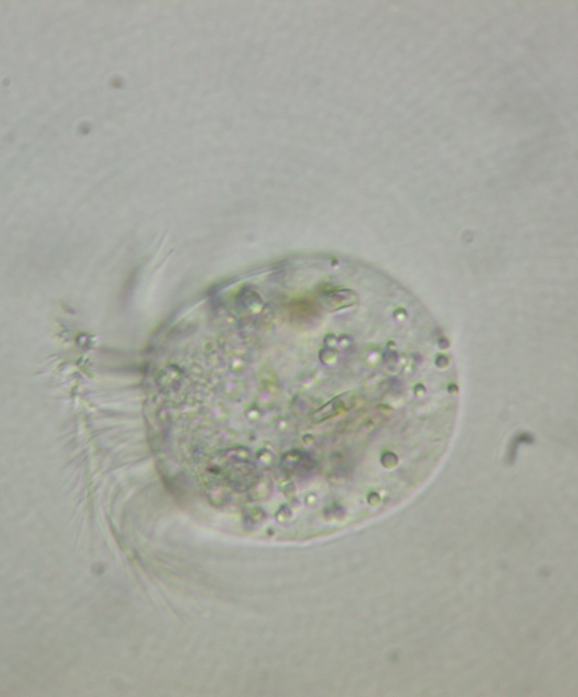
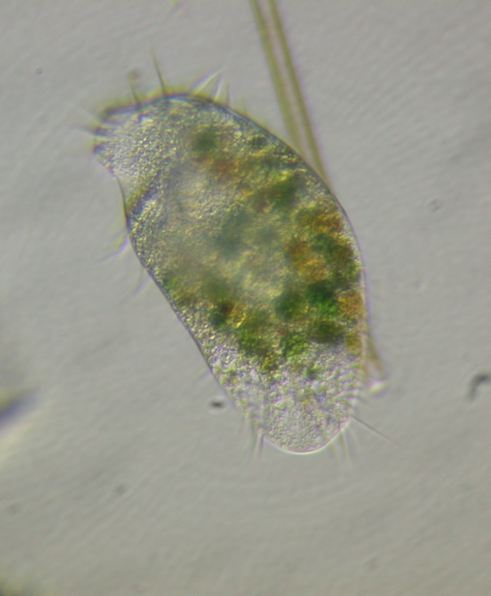
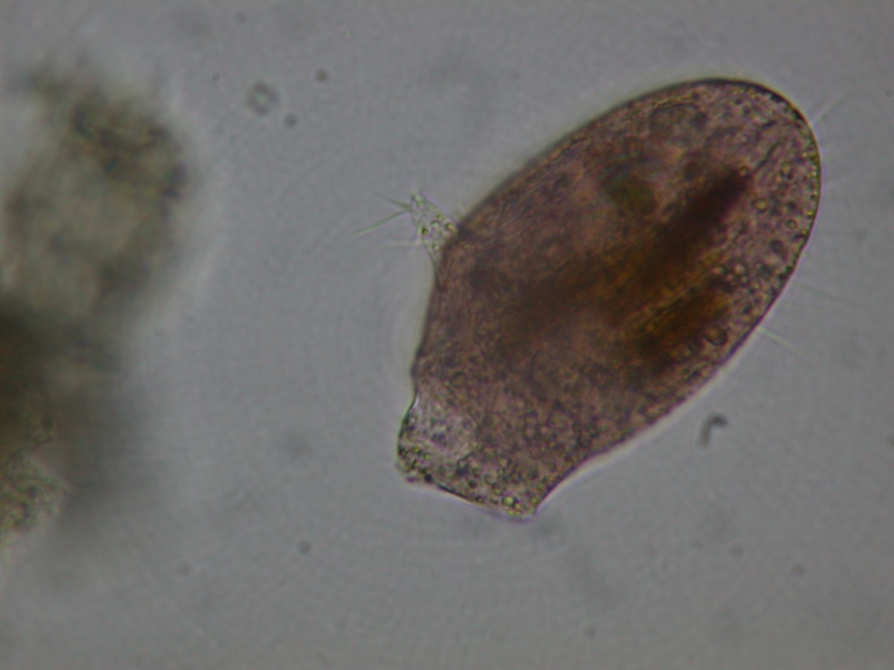
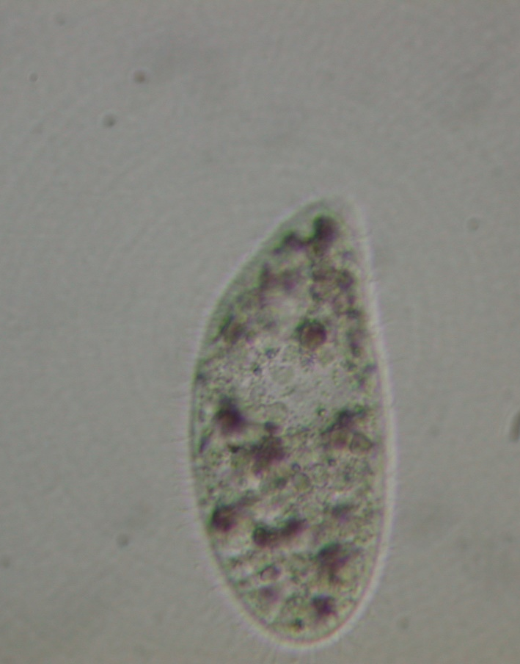
Lohmanniella oviformis
Stentor coeruleus
Oxytricha
Ciliata
Ophryoglena
Spathidium faurei
Spirotrichea

Slide 12
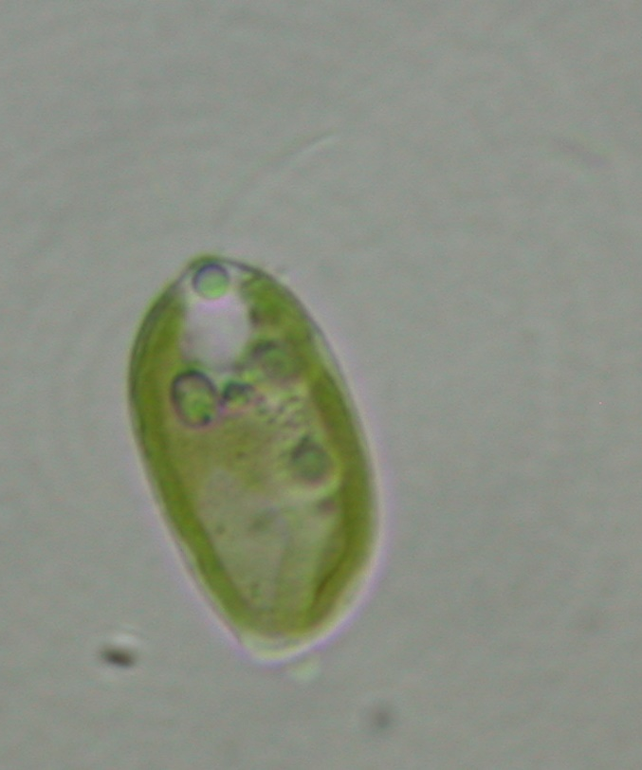
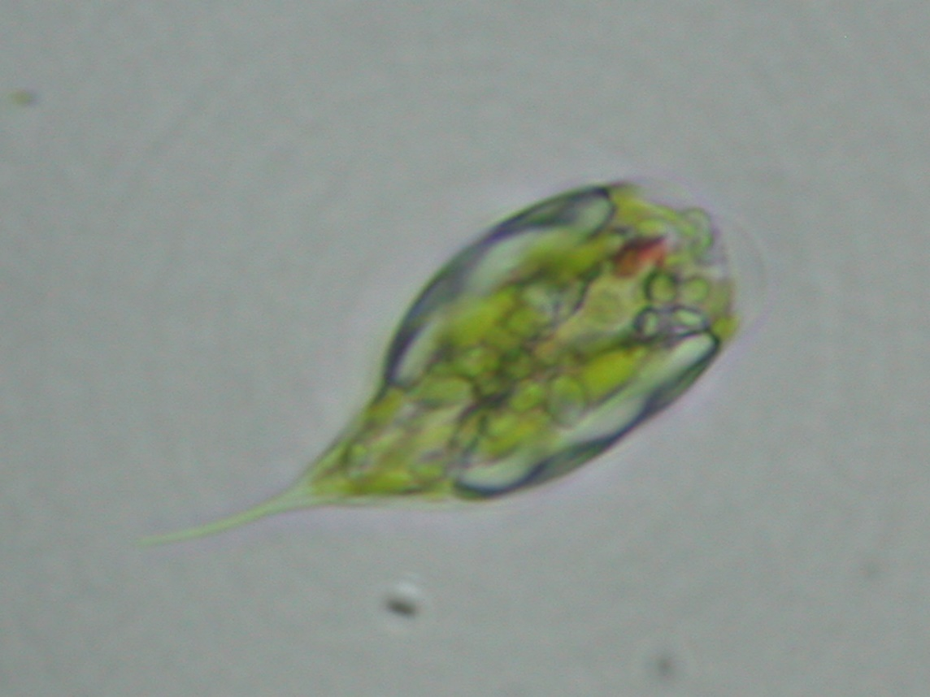
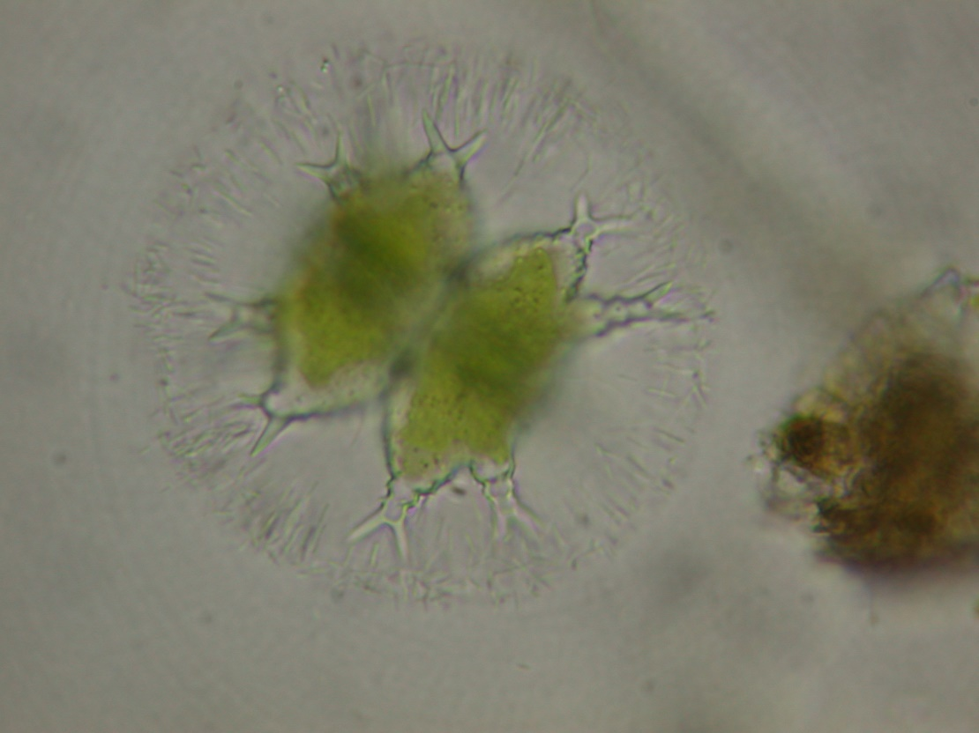
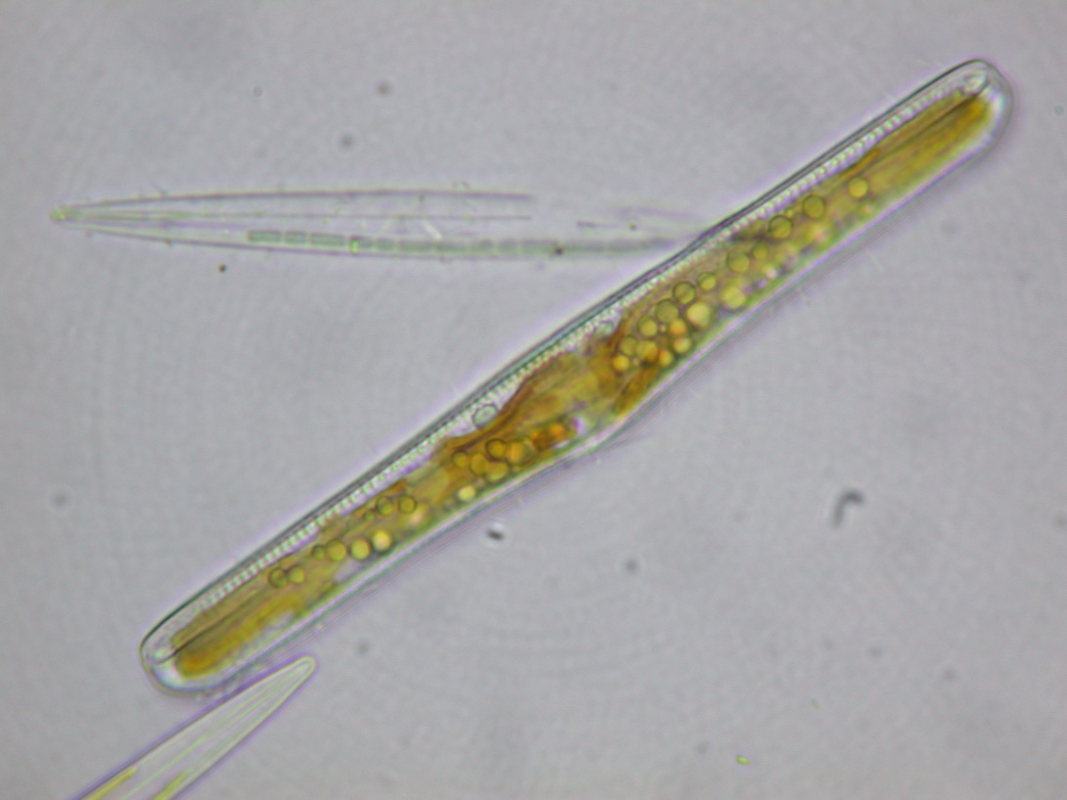
Prymnesium parvum
Prymnesiophyceae, Haptophyta
“algen”
Phacus pyrum
Euglenophyta
Staurastrum arctiscon
Desmidiaceae, Charophyta
Rhopalodia gibba
Diatomea, Heterokonta

