Slide 1
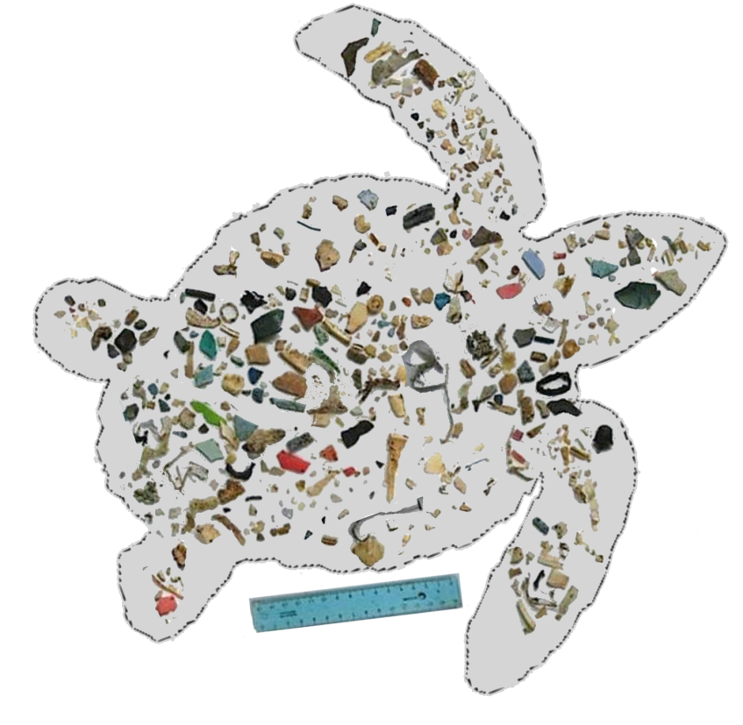


Life cycle and ecology of the loggerhead turtle (Caretta caretta): Development and application of the Dynamic Energy Budget model
Presented by
Bas.Kooijman@vu.nl
MCT PhD thesis award
Wageningen
4 Nov 2016
Exploring the effects of plastic ingestion on the energy budget
Nina Marn
Amsterdam, 30th May 2016
Notes:
Double doctorate at VU University Amsterdam and Zagreb University. Defense at 2016/05/30 in Amsterdam

Slide 2
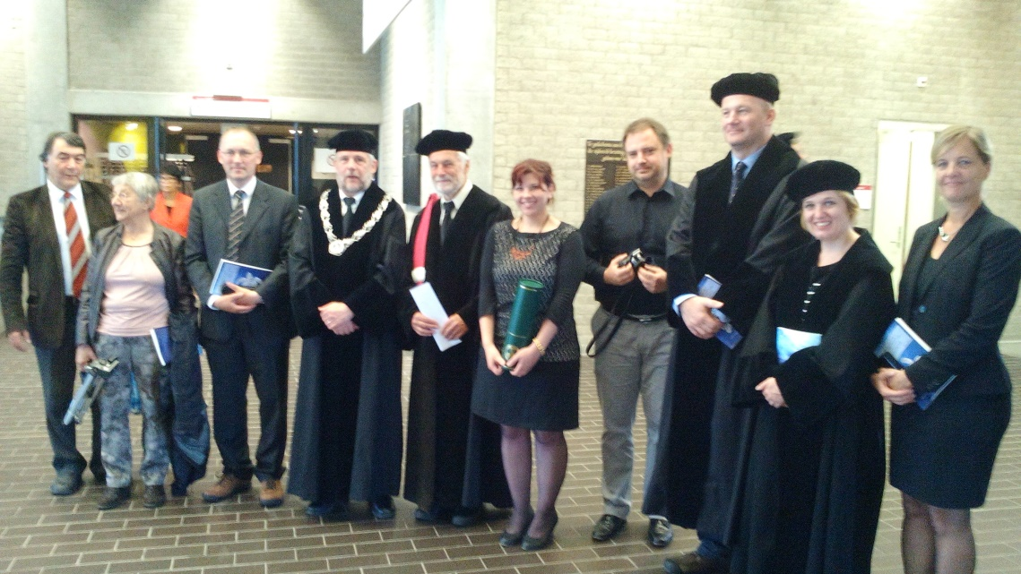

Exploring the effects of plastic ingestion on the energy budget
2016/05/30
Presently: honeymoon in Thailand
Then: family visit in New Zealand
2016/09/17
Nina Marn
Amsterdam, 30th May 2016
Notes:
Nina is from Croatia and just merried Mike from New Zealand. She is now on honeymoon in Thailand, then to Mike’s family. This is why I represent her today.
In Croatia, students acquire funding for a PhD study for 4 yrs through excellent performance.
The first yr is spend on identification of the research topic and of the (local) supervisor.
It has been Nina’s idea to select effects on plastic on seaturtles as topic and to pay attention to modelling, which brought her to Tin Klanjscek (physicist, active in ecological modelling) in Zagreb.
Tin knew of my work on DEB theory and send her to me. I was impressed by the importance of the topic (also in a DEB context) and by her talents.
Nina and I collaborated intensively on the topic during this period.
After courses on DEB theory and on plastics in the environment, she managed to complete her study within the time schedule of her project. I think that this already is an excellent performance, given the amount of material that needs digestion: ecophysiology, DEB theory, mathematics, coding, interaction with experimental biologists; she also assisted in experimental work to become informed about the reliability of measurements and to obtain to the proper data. Pendeling between several research groups is an extra social/time investment.

Slide 3
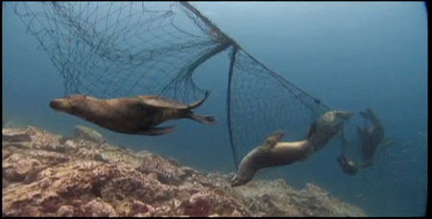
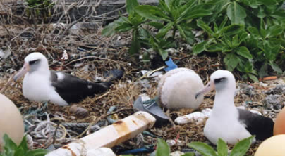
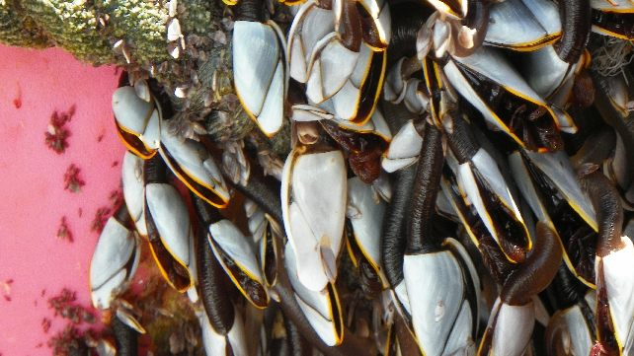
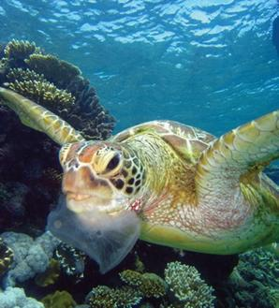
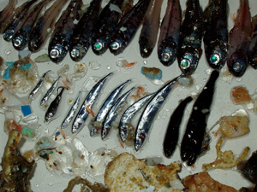
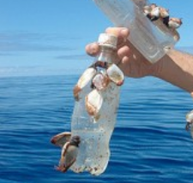
Why effects of plastic?
?
100 millions tons of plastics in the ocean
around 80% marine debris is plastic
almost 300 marine species affected
Notes:
Nina selected plastic, because it is a mayor thread to global environment that is still rapidly growing in significance. Dumping rates are orders of magnitude larger than decomposition rates.
For problems with plastic in the environment it is not 5 minutes to 12, but 5 minutes after 12!
It does not become an environmental disaster, but actually is an environmental disaster.
“Fruits du Mer” represent a substantial proportion of global food intake by humans; seafish already represents 17% of this intake.
https://www.msc.org/healthy-oceans/the-oceans-today/fish-as-food
44% of the world population of humans live within 150 km from the coast
https://coastalchallenges.com/2010/01/31/un-atlas-60-of-us-live-in-the-coastal-areas/

Slide 4
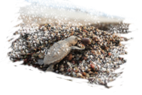
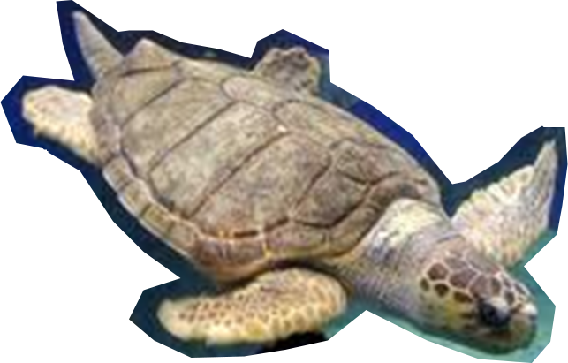
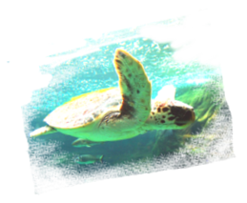
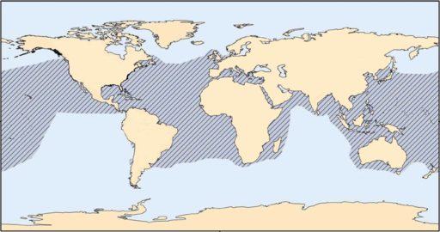
Why loggerhead sea turtles?
long lived accumulation of effects
migratory extreme exposure to plastic
vulnerable environ. & anthropogenic pressures
endangered
different (sub)populations
disjointed conflicting data
age, growth, maturation, size
Notes:
Nina selected sea turtles, since the expectation was/is that effects of plastics are likely to surface in sea turtles first, for several reasons.
The expectation was also that an in-depth study on one species tells more than a superficial one on many; moreover the literature has already quite a few of such studies.

Slide 5
Ecotox PhD’s at Theoretical Biology VU:
2016/05/30 Nina Marn: Effects of plastic on seaturtles
2014/02/10 Natnael Hamda: Toxicant and food stress in springtails
2013/06/13 Elke Zimmer: Toxicant and food stress in pond snails
2013/06/13 Bill Martin: Consequences of effects on individuals for populations
2012/04/23 Starrlight Augustine: Effects of uranium on development
2010/06/29 Daniel Bontje: Toxicant and nutrient stress in ecosystems
2010/01/18 Jan Baas: Effects of mixtures
2005/09/20 Peter Hobbelen: Effect of metals on ecosystems
2003/12/09 Ineborg van Leeuwen: Cancer risk assessment and aging
1998/09/24 Gineke van der Molen: Kinetics of dioxine in humans
1995/06/12 Rob van Haren: Kinetics of xenobiotics
1993/11/04 Janneke Hoestra: Statistics in ecotoxicology
1992/09/17 Joke van Wensem: Effects on decomposing leaf litter
13 of 50 theses on ecotoxicology, all on Dynamic Energy Budget (DEB) theory
Notes:
During my stay at TNO Delft (1977-1983), I became aware of the need for a DEB theory to understand and quantify effects of chemicals.
Then I realised that, more generally, the environment affects individuals (the units of evolutionairy selection) and this has population and ecosystem consequences.
This more general context did not affect my interest in ecotoxicity and about 25% of the theses that I supervised are in the ecotoxicity field.
The topics cover many aspects of exotoxicology. Since effects of stress are deviations from unstressed performance, the latter is key to understand effects. See
http://www.bio.vu.nl/thb/research/bib/Kooy2016b.html
The rest of the theses aim to capture just that at the various levels of organisation.
Quite a few others are in related fields, such as decomposition of chemicals by microorganisms, including co-metabolism, adaptation, flocculated growth in sewage treatment plants etc (relevance to exposure and time scale of effects). We also did a lot on fisheries and aqua-culture, revelant in the context of this thesis on effects of plastic.
For a full list of all 50 theses at Theoretical Biology VU, see
www.bio.vu.nl/thb/education/graduates.html

Slide 6
Effects in DEB context:
Environment affects performance of individuals
food (nutrients/light), temperature (global change), chemicals (ecotox)
Population dynamics depends on individuals
Ecosystem dynamics depends on populations
Effects of compounds
exposure transport, transformation (degradation, co-metabolism)
kinetics uptake, elimination, transformation
change in DEB parameters linked to internal conc’s
Key:
one model that applies for all species on earth micro’s, animals, plants
parameter ↔ single underlying physiological process
Notes:
This summarizes the coherence in the ambitious research program of the dept Theoretical Biology@VU over 30 yrs, with applications in many fields
(ecotox, global change, (aqua)culture, fisheries, medicine).
We have been successful in constructing one model that applies to all species on earth through their full life cycle,
respecting mass balances and stoichiometric & thermodynamic constraints.
Many famous empirical models (going back to Lavoisier 1780 on indirect calorimetry) turn out to be special cases of DEB theory, but now mechanistically explained.
It is simple enough to be practically applicable to many species using existing data in the literature.
The add_my_pet collection of data and parameters on animal species shows a mean relative error of just 11% over all its 430 entries.
More than 500 papers appeared, in which DEB theory plays a key role
http://www.bio.vu.nl/thb/deb/DEB_papers.pdf
A recent introduction to DEB theory in Physics Life Reviews 2016, co-authored by Nina Marn, can be found at:
http://www.sciencedirect.com/science/journal/aip/15710645

Slide 7
What needed to be done?
Estimate parameters for Loggerheads from data
make sense of confusing data in lit; need to delineate life stages
North Atlantic & Mediterranean populations appeared to differ
Analyse implied eco-physiological properties
comparison of populations, with other species
Study effects of food intake reduction by eating plastic
quantify using theory for Synthesizing Units (one of the DEB modules)
similarity with speudo-faces production in bivalves
scenario analysis
Notes:
Work on the thesis has 3 phases.
Ad 1) Estimating parameters takes more than collecting data and pressing a button.
The literature uses different length measures, which resulted in different growth/size estimates that hampered clear conclusions.
Neonates live near the coast, then venture out into the open ocean, to later return to coastal areas, but variations exist: variations in food and temperature.
Mediterranaen populations appeared to have adaptation of some parameter values in response to the low (primary & secondary) production level in this inland sea.
There was a need to split up data to arrive a good fits
Ad 2) In what parameters exactly did the population differ, and how do the values compare to other sea turtle species in the add_my_pet collection?
What are the eco-physiological consequences of these values? Are they consistent with what we think we know?
Are there remarkable implications that invite for future checking?
Ad 3) Effects of plastic very much depend on particle size: large sizes primarily affect food intake by hampering food searching and digestion.
What is the effect of plastic ingestion on food intake quantitatively, and how does this compare with measured loading of the digestive system?
DEB theory for Synthesizing Units have been used; relates to enzyme kinetics, but based on fluxes only, not on concentrations.
Similarity with pseudo-faces production in bivalves that filter slick: http://www.bio.vu.nl/thb/research/bib/Kooy2006.html
Can we computer-simulate realistic scenarios for actual food intake profiles and study the effects of realistic effects of plastic at measured exposure levels?

Slide 8
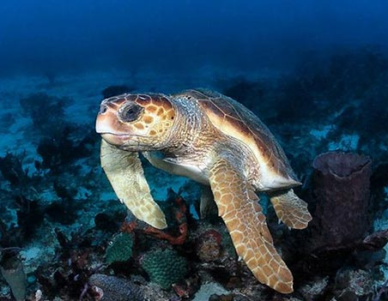
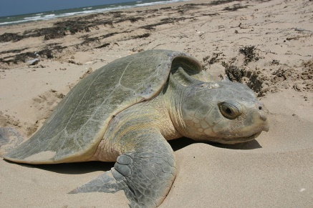
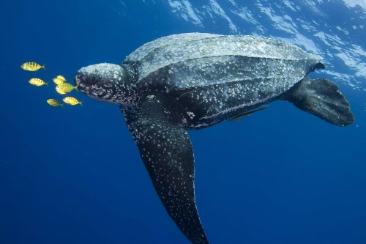
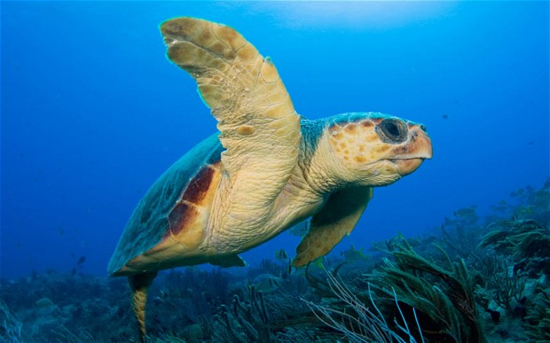
Results:
parameter values consistent with those for other species
model predictions describe data well
possible to describe the whole life cycle
Loggerhead Turtle
Kemps Ridley Turtle
Leatherback Turtle
North Atlantic
Mediterranean
Notes:
Working with models always has the risk of arriving at a good fit for the wrong reasons.
In the present case, all parameters have a clear physiological meaning and
their values can be compared with more than 400 other animal species, and especially 2 other sea turtles species in the add_my-pet collection
http://www.bio.vu.nl/thb/deb/deblab/add_my_pet/
The observed consistency confirms that we arrived at a good fit for the correct reasons.

Slide 9
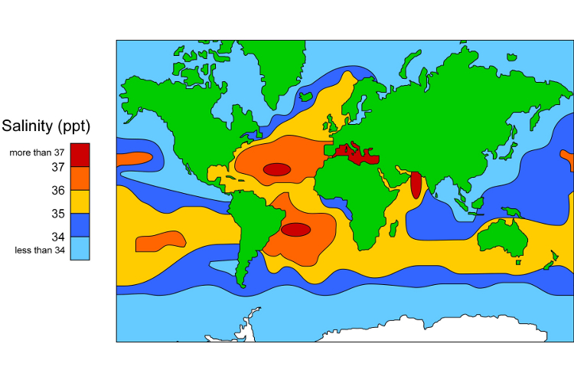
DEB parameters (Med)
smaller size of adults
Related to higher salinity?
maintenance cost
(volume-specific)
Notes:
An eye-catching difference between Mediterrean and North Atlantic inidivuals is that the remain smaller and have higher specific somatic maintenance costs.

Slide 10
DEB parameters (Med)
smaller size and age at puberty
energy investment to reach puberty level
daily maturity maintenance
Notes:
Mediterranean individuals also have a smaller sizer and age at puberty (= start of allocation to reproduction), compared to North Atlantic individuals.
This means that their maturity level at puberty is lower and they have less maturity maintenance costs as result.

Slide 11
DEB parameters (Med)
smaller size and age at puberty
energy investment to reach puberty level
daily maturity maintenance
reproduction at a lower food level
Notes:
But another important consequence is that they can reproduce at a lower level of food availebility

Slide 12
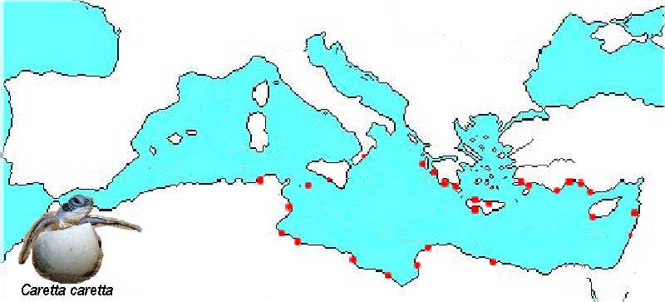
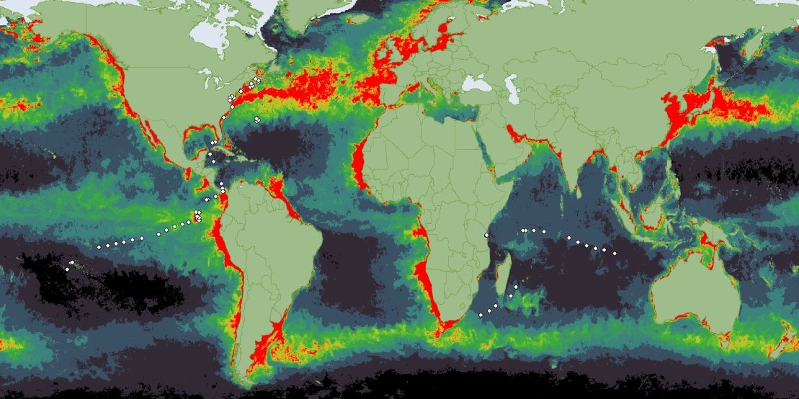
DEB parameters (Med)
smaller size and age at puberty
nesting locations
energy investment to reach puberty level
daily maturity maintenance
reproduction at a lower food level
loggerheads
An evolutionary adaptation to lower food availability?
By NOAA (NOAA) [Public domain]
Notes:
Apart from having a high salinity, the Mediterranean Sea also has a low productivity, probably due to the little rain in its coastal areas, which limits nutrient input into the sea, that fuels primary production. The parameter difference with the North Atlantic population might be an evolutionary adaptation to these local environmental conditions.

Slide 13
Mediterranean & North Atlantic loggerheads
Observation:
NA loggerheads often visit the Mediterranean, but do not reproduce
Result from DEB analysis:
Given the parameter values for both populations:
NA loggerheads are not able to reproduction in the Med. Sea
Adaptation of par values requires very long time
Loggerheads are living at the edge of their capabilities
Notes:
We now can actually understand why the visiting North Atlantic individuals were never observed to reproduce: they cannot, given their parameter values.
Like the other sea turtle species, loggerhead live on the edge of their capabilities.

Slide 14
At lower food availability
slower maturation and lower reproduction
slower growth and smaller size of adults
Notes:
Caloric restrictions slows down maturation, reproduction and growth and results in smaller sized fully growns

Slide 15
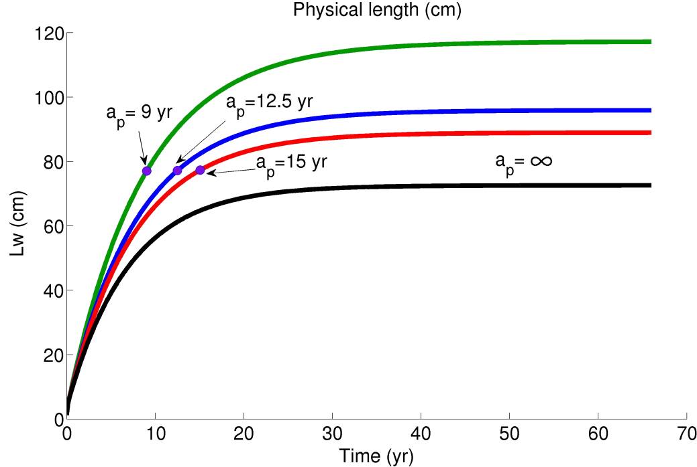
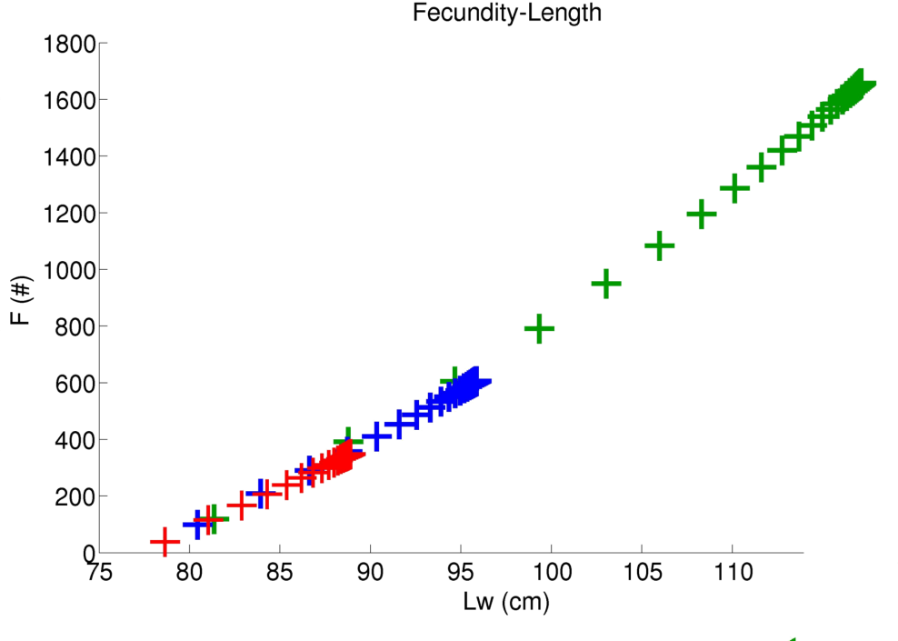
At lower food availability
slower maturation and lower reproduction quantified
slower growth and smaller size of adults quantified
for nesting each other year
Notes:
Lower food intake also results in slightly smaller size at puberty, but greatly increases age at puberty. We can now fully quantify expected effects.

Slide 16
How much plastic?
at 14% of gut contents occupied by plastic reproduction not likely
even if food and plastic have the same gut residence time
at 3 % of gut contents occupied by plastic puberty cannot be reached
if plastic remains in the gut 3 times longer than food
this level is already frequently seen in practice
Notes:
It is likely that plastic stays longer in the gut than food, which means that frequently observe plastic loading prevents reproduction already

Slide 17

Conclusions
mechanistic models
    combining different types of data
    simulations for various food and temperature scenarios
    physiological properties of organisms
    daily energy allocation to processes defining the life-cycle
    defining stress as deviations from unstressed performance
Notes:
Nina summerized the conclusions of her work on the thesis as being dual
first: the use of mechanistic modelling did help a lot in understanding the problem and in quantifying unstressed and stressed eco-physiological performance

Slide 18

Conclusions
mechanistic models
plastic waste
    lower food availability leads to population decline
    both residence time and amount of plastics in the gut need to be taken into account
    education and better waste management necessary
Notes:
but second:
the plastic problem is already a lot bigger than she thought at the start of the thesis and is likely to increase even more in the near future
Better education and waste management are urgently needed

Slide 19
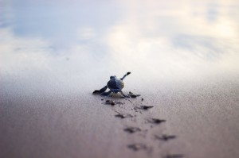
DEB tele course 2017
http://www.bio.vu.nl/thb/deb/
Program for 2017 Starrlight.Augustine@akvaplan.niva.no
general theory (5w, tele mode): 2017/03/02-04/06
free of financial costs; 108 or 216 h effort investment
school & symp in Tromsø (N): 2017/05/21-30
Target audience: PhD students
We encourage participation in groups
who organize local meetings weekly
Software package DEBtool Matlab freely downloadable
Slides of this presentation: http://www.bio.vu.nl/thb/users/bas/lectures/
Audience:
thank you for your attention
Notes:
Registration is open: organizer is Starrlight.Augustine@akvaplan.niva.no
We expect 150 participants in the tele-part from all over the world.
We expect 50 participants in the school and 100 participants in the symposium, both in Tromsø, Norway.
Symposium lectures are mostly by participants of previous courses (>1000), but some participants and key notes will be by newcomers to DEB theory.

