Slide 1

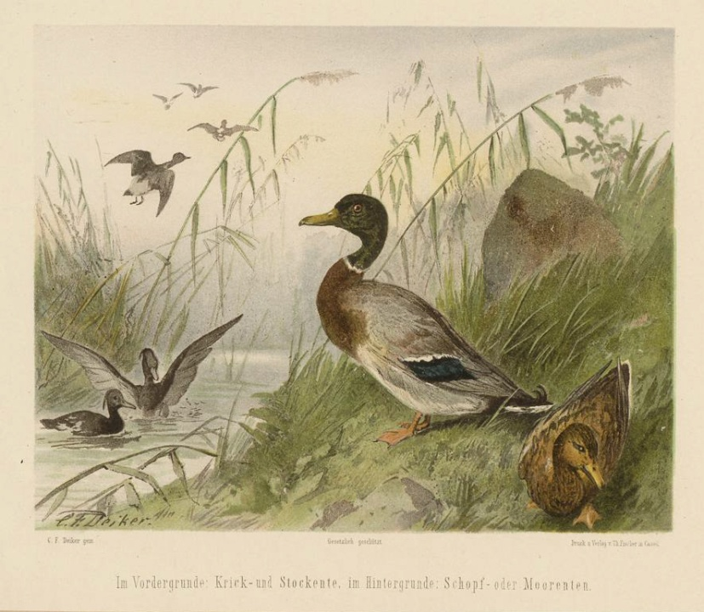
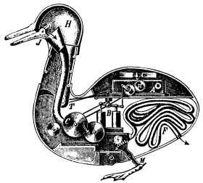

How to simplify biology to interpret effects of stressors
Tjalling Jager
Dept. Theoretical Biology

Slide 2
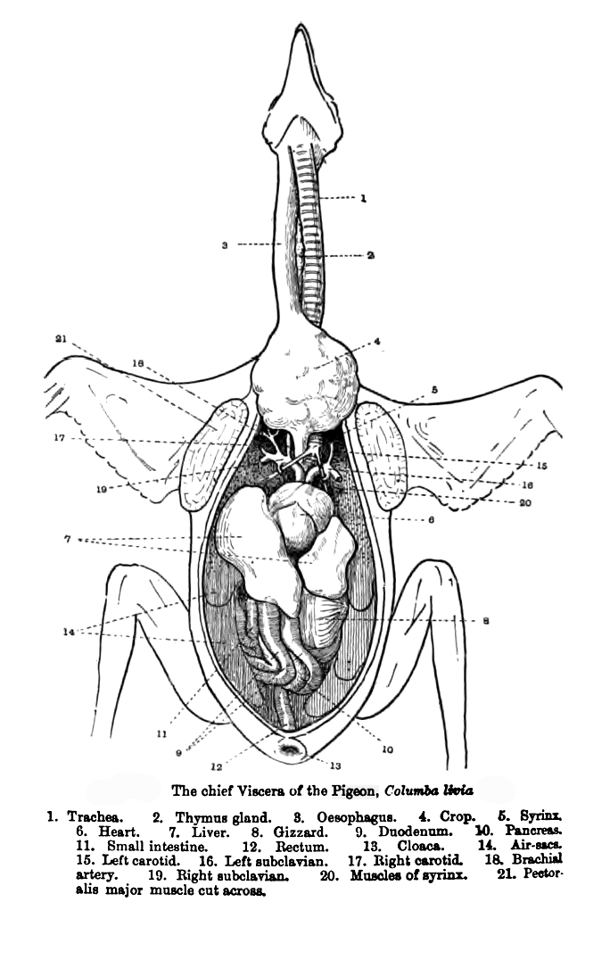
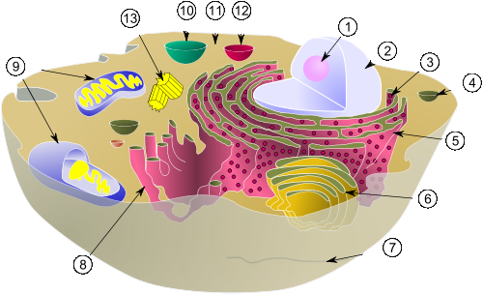

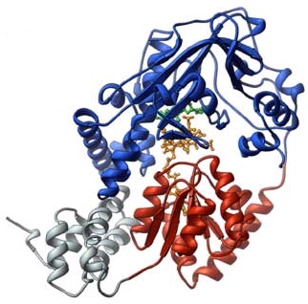

Organisms are complex …

Slide 3
Stressing organisms …
… only adds to the complexity
Response to a toxic (and other) stress depends on
  organism
  endpoint
  type of stressor or toxicant
  exposure scenario
  environmental conditions
Eco(toxico)logical literature is full of descriptions:
“The effect of stressor A on endpoint B of species C (under influence of environmental factor D)”

Slide 4
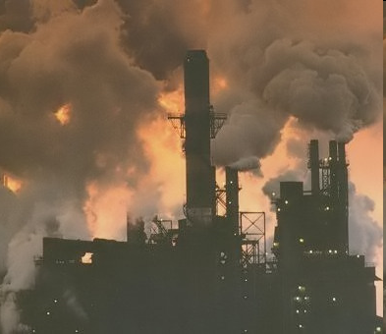
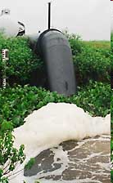

Practical challenge
Some 100,000 man-made chemicals
Wide range of other stressors
For animals alone, >1 million species described
Complex dynamic exposure situations
“The effect of stressor A on endpoint B of species C (under influence of environmental factor D)”

Slide 5
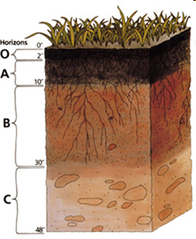
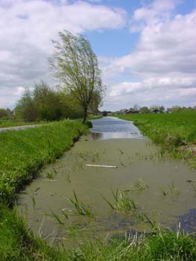
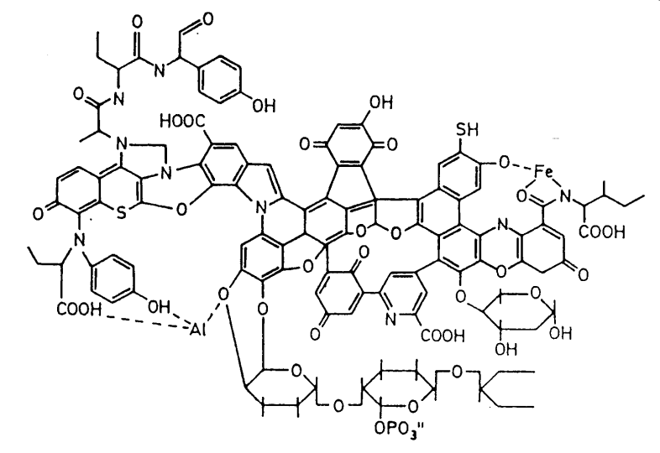
Complexity
Environmental chemistry …

Slide 6
Idealisation
Treat each compartment as homogeneous …

Slide 7


Simplifying biology?
At the level of the individual …
how much biological detail do we minimally need …
  to explain how organisms grow, develop and reproduce
  to explain effects of stressors on life history
  to predict effects for untested cases
  without being species- or stressor-specific

Slide 8
Simplifying biology?
At the level of the individual …
how much biological detail do we minimally need …
  to explain how organisms grow, develop and reproduce
  to explain effects of stressors on life history
  to predict effects for untested cases
  without being species- or stressor-specific
One of the few hard laws in biology …
all organisms obey conservation of mass and energy

Slide 9

Effect on reproduction
Notes:
Now we turn to the sub-lethal effects, and try to answer the question: how is reproduction affected by a toxicant? When we observe that a toxicant decreases the number of offspring, we should not start with questions about the significance of the effect, or estimate an ECx, we first have to ask WHY!
Offspring are not made out of thin air; the organism has to feed to produce juveniles. So when less resources are used for offspring, the reason could be that the toxicant is decreasing the feeding rate.
---------------------------------------------------------------------------------------------------
It is also possible that the feeding rate is still the same, but that the organism needs resources to detoxify the chemical, or to repair damage, and that less resources are available to reproduce.
---------------------------------------------------------------------------------------------------
And it is also possible that the investment in juveniles is the same, but that the toxicant kills the developing embryos.

Slide 10
Effect on reproduction

Slide 11
Effect on reproduction
Notes:
Now we turn to the sub-lethal effects, and try to answer the question: how is reproduction affected by a toxicant? When we observe that a toxicant decreases the number of offspring, we should not start with questions about the significance of the effect, or estimate an ECx, we first have to ask WHY!
Offspring are not made out of thin air; the organism has to feed to produce juveniles. So when less resources are used for offspring, the reason could be that the toxicant is decreasing the feeding rate.
---------------------------------------------------------------------------------------------------
It is also possible that the feeding rate is still the same, but that the organism needs resources to detoxify the chemical, or to repair damage, and that less resources are available to reproduce.
---------------------------------------------------------------------------------------------------
And it is also possible that the investment in juveniles is the same, but that the toxicant kills the developing embryos.

Slide 12
Effect on reproduction

Slide 13
Effect on reproduction

Slide 14
Energy Budget
To understand effect on reproduction …
  we have to consider how food is turned into offspring
Challenge
  find the simplest set of rules ...
  over the entire life cycle ...
  for all organisms (related species follow related rules)

Slide 15
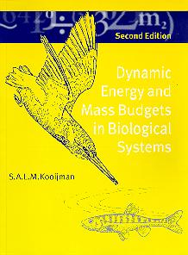
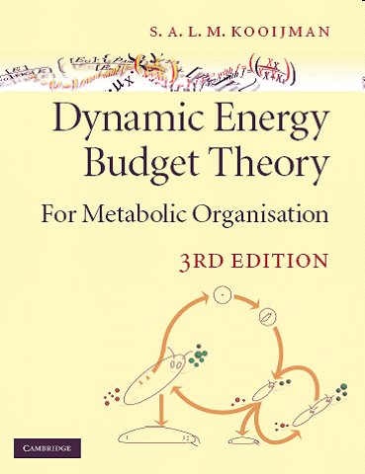
DEB theory
Quantitative theory for metabolic organisation from ‘first principles’
  time, energy and mass balance
  consistent with thermodynamics
Life-cycle of the individual
  links levels of organisation: molecule → ecosystems
Fundamental; many practical applications
  (bio)production, (eco)toxicity, climate change, evolution …
Kooijman (2000)
Kooijman (2010)

Slide 16
Standard DEB animal
food
b
feces
assimilation
3-4 states
8-12 parameters
system can be scaled to remove dimension ‘energy’
reserve
mobilisation
somatic maintenance
κ
1-κ
maturity maintenance
growth
maturation
p
reproduction
structure
maturity
buffer
eggs

Slide 17
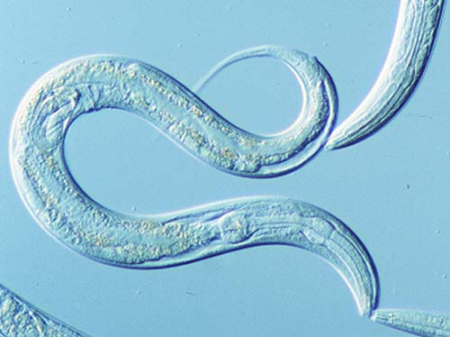
Different food densities
Jager et al. (2005)

Slide 18
Toxicant effects in DEB
parasites
external
concentration
(in time)
environmental stress
toxico-
kinetics
internal
concentration
in time
over entire life cycle
DEB
parameters
in time
repro
growth
DEB
model
survival
feeding
hatching
…
Kooijman & Bedaux (1996),
Jager et al. (2006, 2010)

Slide 19
Toxicant effects in DEB
Affected DEB parameter has specific consequences for life cycle
external
concentration
(in time)
toxico-
kinetics
internal
concentration
in time
DEB
parameters
in time
repro
growth
DEB
model
survival
feeding
hatching
…
Kooijman & Bedaux (1996),
Jager et al. (2006, 2010)

Slide 20
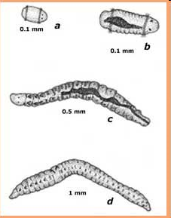
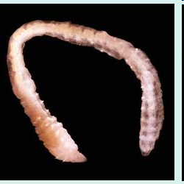
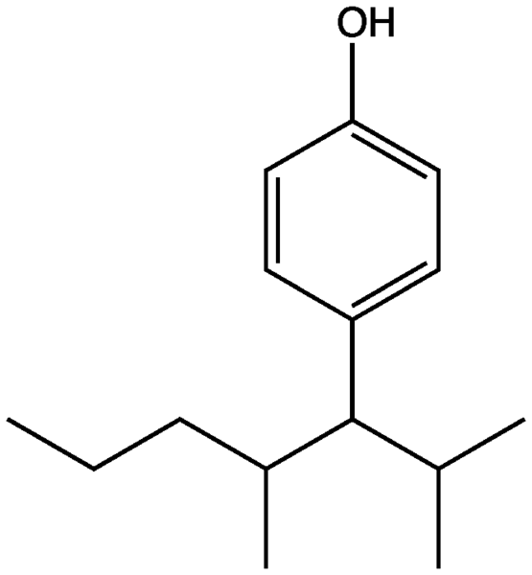
Toxicant case study
Marine polychaete Capitella (Hansen et al, 1999)
  exposed to nonylphenol in sediment
  body volume and egg production followed
  no effect on mortality observed
Jager and Selck (acc.)

Slide 21
Control growth
Volumetric body length in control
  here, assume no contribution reserve to volume …
3
2.5
2
0
volumetric body length (mm)
1.5
1
0.5
0
0
10
20
30
40
50
60
70
80
time (days)

Slide 22
Control growth
Assumption
  effective food density depends on body size
3
2.5
2
0
volumetric body length (mm)
1.5
1
0.5
0
0
10
20
30
40
50
60
70
80
time (days)

Slide 23
Control growth
Assumption
  initial starvation (swimming and metamorphosis)
3
2.5
2
0
volumetric body length (mm)
1.5
1
0.5
0
0
10
20
30
40
50
60
70
80
time (days)

Slide 24
Control reproduction
Compare to mean reproduction rate from DEB
  ignore reproduction buffer …
3500
3000
2500
2000
cumulative offspring per female
1500
0
1000
500
0
0
10
20
30
40
50
60
70
80
time (days)

Slide 25
NP effects
Compare the control to the first dose

Slide 26
“Hormesis”
Requires a mechanistic explanation …
  organism must obey conservation of mass and energy
Potential assumptions
  NP is a micro-nutrient
  decreased investment elsewhere (e.g., immune system)
  NP relieves a secondary stress (e.g., parasites or fungi)
  NP increases the food availability/quality

Slide 27
NP effects
Assumption
  NP increases food density/quality

Slide 28
NP effects
Assumption
  NP affects costs for making structure

Slide 29
Standard DEB animal
food
feces
assimilation
reserve
mobilisation
somatic maintenance
κ
1-κ
maturity maintenance
growth
maturation
reproduction
structure
maturity
buffer
eggs

Slide 30
NP effects
Assumption
  NP also affects costs for maturation and reproduction

Slide 31
Standard DEB animal
food
feces
assimilation
reserve
mobilisation
somatic maintenance
κ
1-κ
maturity maintenance
growth
maturation
reproduction
structure
maturity
buffer
eggs

Slide 32
Strategy for data analysis
standard
DEB model
actual
DEB model
experimental
data
fit
fit not satisfactory?
additional
experiments
mechanistic
hypothesis
literature
educated
guesses

Slide 33
Strategy for data analysis
Are we sure we have the correct explanation?
Occam’s razor
Accept the simplest explanation … for now
actual
DEB model
testable
predictions

Slide 34
Concluding remarks
Understanding stressor effects in eco(toxico)logy is served by idealisation of biology
Stressor effects can be treated quantitatively, ensuring:
  mass and energy balance
  consistent changes in all life-history traits (trade-offs)
Increase understanding of stressors, but also of metabolic organisation
DEB theory offers a platform
  simple, not species- or stressor-specific
  well tested in many applications

Slide 35
More information
on DEB: http://www.bio.vu.nl/thb
on DEBtox: http://www.debtox.info
Courses
  International DEB Tele Course 2013
Symposia
  2nd International DEB Symposium 2013 on Texel (NL)

