Slide 1


Predicting mixture effects
the causality chain from molecule to population
Tjalling Jager
Dept. Theoretical Biology

Slide 2
Contents
Complexity of multiple stress
Classic mixture approach
Following the causality chain
Case studies with TKTD models
Take home messages

Slide 3
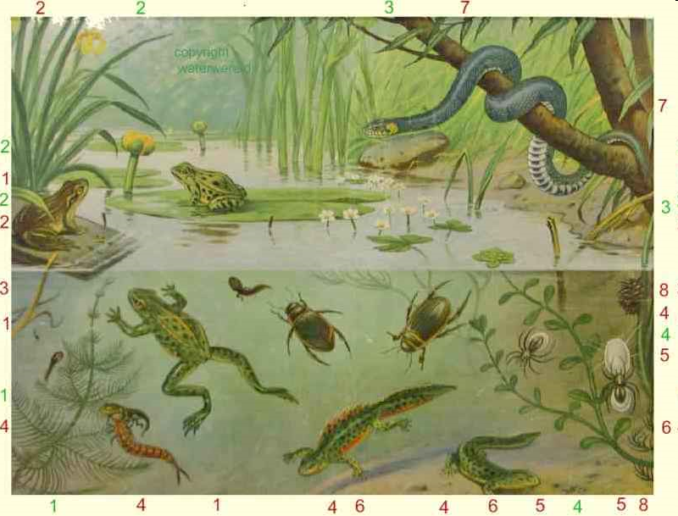
Complexity of multi-stress
Predictions at the population/community level
In the field, multiple stress is the norm
Questions:
  do stresses add up?
  do stressors interact?

Slide 4
Complexity of multi-stress
insecticidal
Bt-proteins
xenobiotic
chemicals
environmental
stress
intra-species
interactions
inter-species
interactions

Slide 5

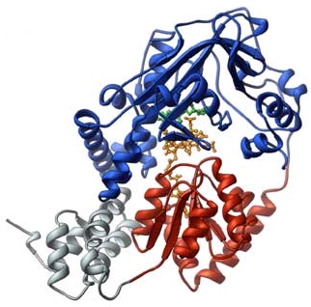
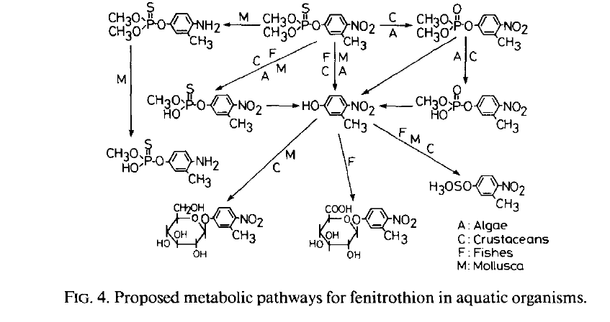
Current status
Ecotoxicological research:
descriptive at the individual level
mechanistic at the molecular level
sketchy at population/community level
response
dose

Slide 6
Classic mixture models
Dose-response curve for compound A and B
response
response
dose A
dose B

Slide 7
Classic mixture models
Combine using reference model:
  “response multiplication”: chemicals act independently
  “concentration addition”: chemicals act as dilutions
response
response
dose A
dose A
dose B
dose B

Slide 8
Classic mixture models
Combine using reference model:
  “response multiplication”: chemicals act independently
  “concentration addition”: chemicals act as dilutions
50% effect
antagonism
dose B
dose B
antagonism
50% effect
synergism
synergism
dose A
dose A

Slide 9
What is the relevance?
This analysis is usually done …
with one reference model,
for one endpoint,
at one time point.

Slide 10
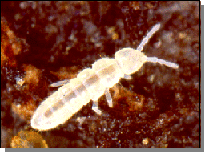
What is the relevance?
Van Gestel & Hensbergen (1997)
Environ. Toxicol. Chem.
5
body weight
reproduction
4
3
Cadmium and zinc
Reference: conc. add.
TU mixture 50% effect
2
ant.
1
syn.
0
0
1
2
3
4
5
6
time (weeks)

Slide 11
What is the relevance?
This analysis is usually done …
with one reference model,
for one endpoint,
at one time point.
And test conducted …
at constant exposure,
under one set of conditions.

Slide 12
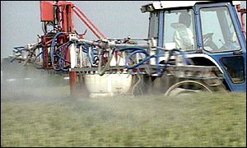
Causality chain
toxico-
kinetics
mechanistic
studies
toxicity
testing
protection
goals
?
external exposure
internal exposure
molecular targets
life-history traits
population dynamics

Slide 13

Effect on reproduction
Notes:
Now we turn to the sub-lethal effects, and try to answer the question: how is reproduction affected by a toxicant? When we observe that a toxicant decreases the number of offspring, we should not start with questions about the significance of the effect, or estimate an ECx, we first have to ask WHY!
Offspring are not made out of thin air; the organism has to feed to produce juveniles. So when less resources are used for offspring, the reason could be that the toxicant is decreasing the feeding rate.
---------------------------------------------------------------------------------------------------
It is also possible that the feeding rate is still the same, but that the organism needs resources to detoxify the chemical, or to repair damage, and that less resources are available to reproduce.
---------------------------------------------------------------------------------------------------
And it is also possible that the investment in juveniles is the same, but that the toxicant kills the developing embryos.

Slide 14
Effect on reproduction

Slide 15
Effect on reproduction
Notes:
Now we turn to the sub-lethal effects, and try to answer the question: how is reproduction affected by a toxicant? When we observe that a toxicant decreases the number of offspring, we should not start with questions about the significance of the effect, or estimate an ECx, we first have to ask WHY!
Offspring are not made out of thin air; the organism has to feed to produce juveniles. So when less resources are used for offspring, the reason could be that the toxicant is decreasing the feeding rate.
---------------------------------------------------------------------------------------------------
It is also possible that the feeding rate is still the same, but that the organism needs resources to detoxify the chemical, or to repair damage, and that less resources are available to reproduce.
---------------------------------------------------------------------------------------------------
And it is also possible that the investment in juveniles is the same, but that the toxicant kills the developing embryos.

Slide 16
Effect on reproduction

Slide 17
Effect on reproduction
No single pathway for effects on reproduction!

Slide 18
Energy budget
How are resources used to fuel life history?
Subject of DEB theory
  dynamically linking all traits over the life cycle
Kooijman (2001)
Phil. Trans. B

Slide 19
Causality chain
toxico-
kinetics
mechanistic
studies
energy
budget
toxicity
testing
protection
goals
external exposure
internal exposure
molecular targets
metabolic processes
life-history traits
population dynamics

Slide 20
Causality chain
toxico-
kinetics
mechanistic
studies
energy
budget
toxicity
testing
protection
goals
external exposure
internal exposure
molecular targets
metabolic processes
life-history traits
population dynamics
Fill this chain with mechanistic models …
  predict impact on populations/communities
  deal with time-varying exposure
  extrapolate to different environments
  predict impact of multiple stress ...

Slide 21
Case studies: TKTD
toxico-
kinetics
survival
model
survival
in time
energy
budget
toxicity
testing
‘GUTS’
external exposure
internal exposure
metabolic processes
growth, repro, etc.
‘DEBtox’
toxicokinetics
toxicodynamics
Jager et al. (2011)
Environ. Sci. Technol.
Jager et al. (2006)
Ecotoxicology

Slide 22
Simple mixture rules
compound
‘target’
metabolic process
maintenance costs
growth costs
survival prob.
…
add internal concentrations
(with weights)
Jager et al. (2010)
Ecotoxicology

Slide 23
Simple mixture rules
compound
‘target’
metabolic process
maintenance costs
growth costs
survival prob.
…
Jager et al. (2010)
Ecotoxicology

Slide 24
Simple mixture rules
compound
‘target’
metabolic process
maintenance costs
growth costs
survival prob.
…
combine independent effects
in the energy budget
Jager et al. (2010)
Ecotoxicology

Slide 25
Case study: survival
Mixture of Cd and Cu
Model fit to all survival data in time …
Baas et al. (2007)
Environ. Toxicol. Chem

Slide 26
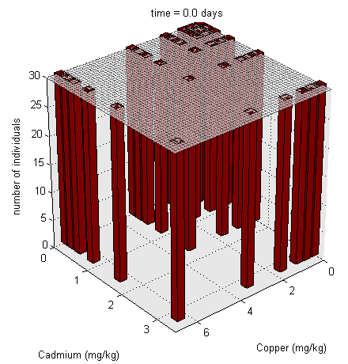
Case study: survival
Mixture of Cd and Cu
Model fit to all survival data in time …
Baas et al. (2007)
Environ. Toxicol. Chem

Slide 27
Case study: sub-lethal
Insecticide fenvalerate and food stress
Based on standard 21-day reproduction test
  survival, size and reproduction over time
  pulse exposure in first 24 hours
  two food levels
Pieters et al. (2006)
Ecotoxicology

Slide 28
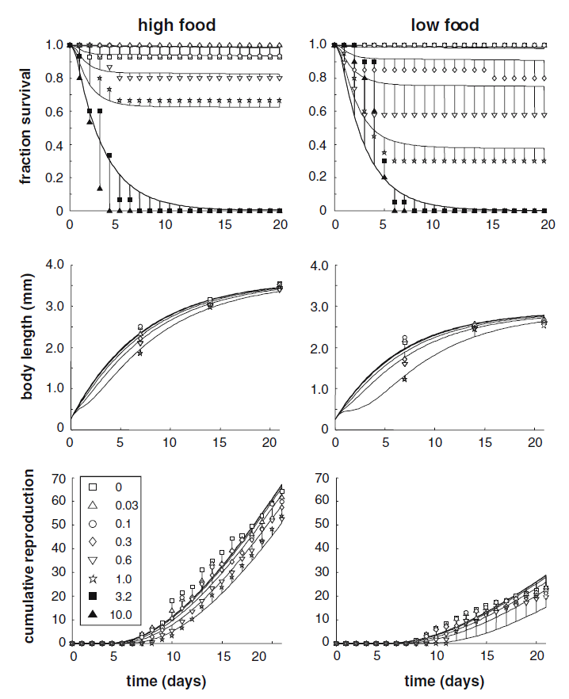
Fenvalerate and food
Same model parameters
  for all endpoints over time
  for 2 food levels
Apparent synergism …
Pieters et al. (2006)
Ecotoxicology

Slide 29
TKTD models
toxico-
kinetics
energy
budget
toxicity
testing
external exposure
internal exposure
metabolic processes
life-history traits
toxicokinetics
toxicodynamics

Slide 30

PAHs in Daphnia
Based on standard 21-day reproduction test
  10 animals per treatment
  length, reproduction and survival every 2 days
fluoranthene
pyrene
Jager et al. (2010)
Ecotoxicology

Slide 31
same target
costs reproduction
(and costs growth)

Slide 32
Iso-effect lines
for body length <50% effect

Slide 33
Causality chain
Requires inter-disciplinary research
?
external exposure
internal exposure
molecular target
metabolic process
life-history traits
population dynamics
environmental
chemistry
molecular
biology
survival models and
energy budgets
population biology
toxicokinetics
toxicity testing
toxicodynamics

Slide 34
Take-home messages
More steps in the causality chain
  not just toxicity testing and molecular mechanisms
  e.g., toxicokinetics, energy budgets, population dynamics
Each step requires mechanistic models
  effects change with time, environment, etc.
  standardisation is not a solution ...
Interactions occur anywhere in the chain
  strong synergistic effects are rare
  interaction is very difficult to predict or to exclude

