Slide 1


Dose-response analysis
Tjalling Jager
Dept. Theoretical Biology

Slide 2
Contents
‘Classic’ dose-response analysis
Background and general approach
Analysis of survival data
Analysis of growth and reproduction data
Dynamic modelling
Limitations of the classic approach
Dynamic modelling as an alternative

Slide 3
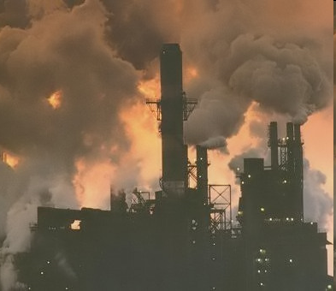
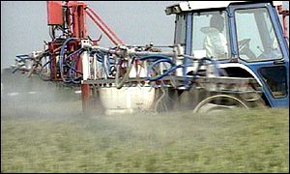

Why dose-response analysis?
How toxic is chemical X?
  for RA of the production or use of X
  for ranking chemicals (compare X to Y)
  for environmental quality standards
Need measure of toxicity that is:
  a good indicator for (no) effects in the field
  comparable between chemicals
Scientific interest:
  how do chemicals affect organisms?
  stress organism to reveal how they work …

Slide 4
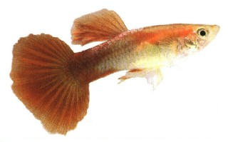
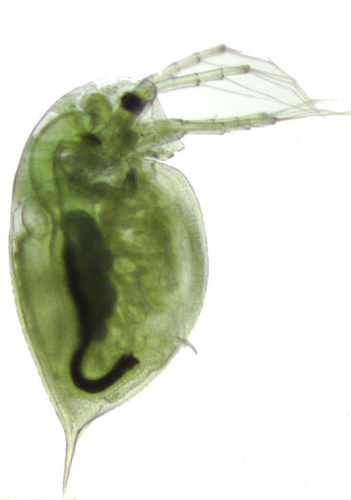

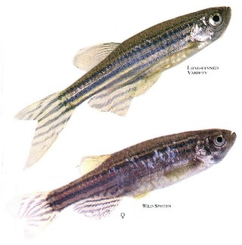
Test organisms (aquatic)

Slide 5
Standardisation
Toxicity tests are highly standardised (OECD, ISO, ASTM etc.):
  species
  exposure time
  endpoints
  test medium, temperature etc.

Slide 6

Reproduction test
50-100 ml of well-defined test medium, 18-22°C

Slide 7

Reproduction test
Daphnia magna Straus, <24 h old

Slide 8
Reproduction test
Daphnia magna Straus, <24 h old

Slide 9

Reproduction test
wait for 21 days, and count total offspring …

Slide 10
Reproduction test
at least 5 test concentrations in geometric series …

Slide 11
Plot response vs. dose
What pattern to expect?
Response
log concentration

Slide 12
Linear?
Response
log concentration

Slide 13
Threshold, linear?
Response
log concentration

Slide 14
Threshold, curve?
Response
log concentration

Slide 15
S-shape?
Response
log concentration

Slide 16
Hormesis?
Response
log concentration

Slide 17
Essential chemical?
Response
log concentration

Slide 18
Standard approaches
Contr.
1. Statistical testing
2. Curve fitting
NOEC
*
LOEC
Response
assumes threshold
log concentration

Slide 19
Standard approaches
1. Statistical testing
2. Curve fitting
EC50
Response
usually no threshold
log concentration

Slide 20
Standard summary statistics
NOEC
highest tested concentration where effect is not significantly different from control
EC50 or LC50
the estimated concentration for 50% effect, compared to control
can be generalised to ECx or LCx

Slide 21
Difference graded-quantal
Quantal: count fraction of animals responding
  e.g., 8 out of 20 = 0.4
  always between 0 and 1 (or 0-100%)
  no standard deviations
  usually mortality or immobility
  LC50, LCx
Graded: measure degree of response for each individual
  e.g., 85 eggs or body weight of 23 g
  between 0 and infinite
  standard deviations when >1 animal
  usually body size or reproduction
  NOEC, ECx

Slide 22
Contents
‘Classic’ dose-response analysis
Background and general approach
Analysis of survival data
Analysis of growth and reproduction data
Dynamic modelling
Limitations of the classic approach
Dynamic modelling as an alternative

Slide 23
Survival analysis
Typical data set
  number of live animals after fixed exposure period
  example: Daphnia exposed to nonylphenol
mg/L | 0 h | 24 h | 48 h
0.004 | 20 | 20 | 20
0.032 | 20 | 20 | 20
0.056 | 20 | 20 | 20
0.100 | 20 | 20 | 20
0.180 | 20 | 20 | 16
0.320 | 20 | 13 | 2
0.560 | 20 | 2 | 0

Slide 24
Plot dose-response curve
Procedure
  plot percentage survival after 48 h
  concentration on log scale
Objective
  derive LC50

Slide 25
What model?
Requirements curve
  start at 100% and monotonically decreasing to zero
  inverse cumulative distribution?

Slide 26
Cumulative distributions
E.g. the normal distribution …
1
probability density
cumulative density

Slide 27
Distribution of what?
Assumptions for “tolerance”
  animal dies instantly when exposure exceeds ‘threshold’
  threshold varies between individuals
  spread of distribution indicates individual variation
1
probability density
cumulative density

Slide 28

Concept of ‘tolerance’
1
1
cumulative density
20% mortality
cumulative density
20% mortality

Slide 29
What is the LC50?
1
1
cumulative density
?
cumulative density
50% mortality
50% mortality

Slide 30
Graphical method
Probit transformation
std. normal distribution + 5
100
100
80
80
60
60
mortality (%)
40
40
20
20
data
0
0
2 3 4 5 6 7 8 9
probits
0.001
0.001
0.01
0.01
0.1
0.1
1
1
concentration (mg/L)
Linear regression on probits versus log concentration

Slide 31
Fit model, least squares?
100
80
Error is not normal:
  discrete numbers of survivors
  response must be between 0-100%
60
survival (%)
40
20
0
0.001
0.01
0.1
1
concentration (mg/L)

Slide 32
How to fit the model
Assumptions
Result at each concentration is binomial trial, B(n,p)
  probability to survive is p, to die 1-p
  predicted p = f(c)
Estimate parameters of the model f
  maximum likelihood estimation is most appropriate
  find parameters that maximise the probability of the sample
1
1

Slide 33
Fit model, least squares?
100
80
60
survival (%)
40
20
0
0.001
0.01
0.1
1
concentration (mg/L)

Slide 34
Max. likelihood estimation
100
80
60
survival (%)
40
20
0
0.001
0.01
0.1
1
concentration (mg/L)

Slide 35
Which model curve?
Popular distributions
  log-normal (probit)
  log-logistic (logit)
  Weibull
ISO/OECD guidance document
A statistical regression model itself does not have any meaning, and the choice of the model is largely arbitrary.

Slide 36
Resulting fits: close-up
 | LC50 | log lik.
Log-logistic | 0.225 | -16.681
Log-normal | 0.226 | -16.541
Weibull | 0.242 | -16.876
Gamma | 0.230 | -16.582
1
0.9
0.8
0.7
0.6
fraction surviving
0.5
0.4
0.3
data
log-logistic
0.2
log-normal
Weibull
0.1
gamma
0
-1
10
concentration

Slide 37
Non-parametric analysis
Spearman-Kärber: wted. average of midpoints
100
weights is number of deaths in interval
for symmetric distribution (on log scale)
80
60
survival (%)
40
20
0
0.001
0.01
0.1
1
log concentration (mg/L)

Slide 38
“Trimmed” Spearman-Kärber
100
Interpolate at 95%
80
60
survival (%)
40
20
Interpolate at 5%
0
0.001
0.01
0.1
1
log concentration (mg/L)

Slide 39
Summary: survival data
Survival data are ‘quantal’ responses
  data are fraction of individuals responding
  possible mechanism can be tolerance distribution
Analysis types
  regression (e.g., log-logistic or log-normal) → LCx
  non-parametric (e.g., Spearman-Kärber) → LC50

Slide 40
Contents
‘Classic’ dose-response analysis
Background and general approach
Analysis of survival data
Analysis of growth and reproduction data
Dynamic modelling
Limitations of the classic approach
Dynamic modelling as an alternative

Slide 41
Difference graded-quantal
Quantal: count fraction of animals responding
  e.g. 8 out of 20 = 0.4
  always between 0% and 100%
  no standard deviations
  usually mortality or immobility
  LC50
Graded: measure degree of response for each individual
  e.g. 85 eggs or body weight of 23 g
  usually between 0 and infinite
  standard deviations when >1 animal
  usually growth or reproduction
  NOEC, ECx

Slide 42
Analysis of continuous data
Endpoints for individual
  in ecotoxicology, usually growth (fish) and reproduction (Daphnia)
Two approaches
  NOEC and LOEC (statistical testing)
  ECx (regression modelling)

Slide 43
Derive NOEC
Contr.
NOEC
*
LOEC
Response
log concentration

Slide 44
Derivation NOEC
ANOVA: are responses in all groups equal? H₀: R(1) = R(2) = R(3) …
Post test: multiple comparisons to control, e.g.:
  t-test with e.g., Bonferroni correction
  Dunnett’s test
  Mann-Whitney test with correction
Trend tests
  stepwise: remove highest dose until no sign. trend is left

Slide 45
What’s wrong?
Inefficient use of data
  most data points are ignored
  NOEC has to be one of the test concentrations
Wrong use of statistics
  no statistically significant effect ≠ no effect
  large variation in effects at the NOEC (<10 – >50%)
  large variability in test leads to high (unprotective) NOECs
But, NOEC is still used!
See e.g., Laskowski (1995), Crane & Newman (2000)

Slide 46
Regression modelling
Select model
  log-logistic (ecotoxicology)
  anything that fits (mainly toxicology)
    straight line
    exponential curve
    polynomial

Slide 47
Least-squares estimation
100
80
60
reproduction (#eggs)
40
Note: LSQ is equivalent to MLE, assuming normally-distributed errors, with constant variance
20
0
0.001
0.01
0.1
1
concentration (mg/L)

Slide 48

Example: Daphnia repro
Standard protocol
  take juveniles <24 h old
  expose to chemical for 21 days
  count number of offspring 3x per week
  use total number of offspring after 21 days
  calculate NOEC and EC50

Slide 49

Example: Daphnia repro
Plot concentration on log-scale
NOEC might be zero ….
100
90
80
70
# juv./female
60
50
40
30
20
10
0
-2
-1
0
1
10
10
10
10
concentration

Slide 50
Example: Daphnia repro
Fit sigmoid curve
Estimate ECx from the curve
100
EC10
0.13 mM
(0.077-0.19)
90
80
70
# juv./female
60
EC50
0.41 mM
(0.33-0.49)
50
40
30
20
10
0
-2
-1
0
1
10
10
10
10
concentration

Slide 51
Regression modelling
Advantage
  use more of the data
  ECx is estimated with confidence interval
  poor data lead to large confidence intervals
But, model is purely empirical
  no understanding of the process
  extrapolation beyond test setup is dangerous!
  interval is valid given that model is true …

Slide 52
Summary: continuous data
Repro/growth data are ‘graded’ responses
  look at average response of individual animals
  not fraction of animals responding!
  thus, we cannot talk about tolerance distributions!
Analysis types
  statistical testing (e.g., ANOVA) → NOEC
  regression (e.g., log-logistic) → ECx

Slide 53

Dynamic modelling
Tjalling Jager
Dept. Theoretical Biology

Slide 54
Contents
‘Classic’ dose-response analysis
Background and general approach
Analysis of survival data
Analysis of growth and reproduction data
Dynamic modelling
Limitations of the classic approach
Dynamic modelling as an alternative

Slide 55

Challenges of ecotox
Some 100,000 man-made chemicals
For animals alone, >1 million species described
Complex dynamic exposure situations
Always combinations of chemicals and other stresses
We cannot (and should not) test all permutations!

Slide 56
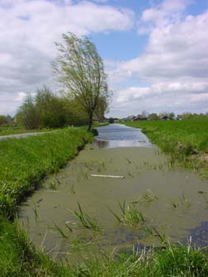
Extrapolation
“Protection goal”
Laboratory tests
??
different exposure time
different temperature
different species
time-variable conditions
limiting food supplies
mixtures of chemicals
…

Slide 57
Extrapolation
single time point
single endpoint
LC50
ECx
NOEC
Response
log
concentration
Available data | Assessment factor
Three LC50s | 1000
One NOEC | 100
Two NOECs | 50
Three NOECs | 10
‘Safe’ level for field system

Slide 58
If EC50 is the answer …
… what was the question?
“What is the concentration of chemical X that leads to 50% effect on the total number of offspring of Daphnia magna (Straus) after 21-day constant exposure under standardised laboratory conditions?”
Is this answer of any use?

Slide 59
Time is of the essence!
Toxicity is a process in time
statistics like LC50/ECx/NOEC change in time
this is hidden by strict standardisation
  Daphnia acute: 2 days
  fish acute: 4 days
  Daphnia repro 21 days
  fish growth 28 days
  …

Slide 60

Effects change in time
 | LC50 | s.d. tolerance
24 hours | 0.370 | 0.306
48 hours | 0.226 | 0.267
1
0.9
0.8
0.7
0.6
fraction surviving
0.5
24 hours
0.4
Note: LC50 will (almost) always decrease in time, often reaching a stable (incipient) value
0.3
48 hours
0.2
0.1
0
0
0.1
0.2
0.3
0.4
0.5
0.6
0.7
concentration

Slide 61
Chronic tests
With time, control response increases and all parameters may change …
100
increasing time (t = 9-21d)
90
80
70
# juv./female
60
50
40
Note: ECx will not always decrease in time!
30
20
10
0
-2
-1
0
1
10
10
10
10
concentration

Slide 62
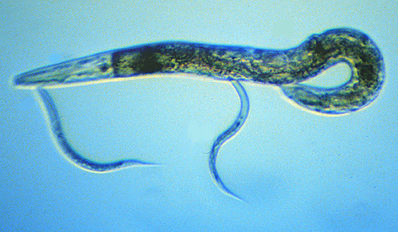
EC10 in time
Alda Álvarez et al. (2006)
survival
body length
carbendazim
cumul. reproduction
pentachlorobenzene
2.5
140
120
2
100
1.5
80
1
60
40
0.5
20
0
0
5
10
15
20
0
0
2
4
6
8
10
12
14
16
time (days)
time (days)

Slide 63

Toxicity is a process in time
Effects change in time, how depends on:
  endpoint chosen
  species tested
  chemical tested
No such thing as the ECx/LC50/NOEC
  these statistics are nothing but a ‘snapshot’
  can we compare chemicals, species, endpoints?
Baas et al. (2010)

Slide 64
Furthermore …
Different endpoints …
have different ecological impact
  10% growth reduction is incomparable to 10% less reproduction or survival
are not independent …
Units matter …
how you express effect changes value of NOEC and ECx
this is also hidden by strict standardisation
  Daphnia : cumulative reproduction
  fish: body weight
  …

Slide 65
Summary “What’s wrong?”
NOEC should be banned!
All classic summary statistics are poor measures of toxicity
  they depend on time
  time pattern varies with endpoint, species and chemical
Therefore
  we cannot compare toxicity between chemicals and species
  we have a poor basis for extrapolating to the field
  we do not really learn a lot …

Slide 66

Why are they still used?
We want to keep our lives simple …
We are conservative …
We have agreed on standard test protocols …
We don’t agree on an alternative …

Slide 67
Contents
‘Classic’ dose-response analysis
Background and general approach
Analysis of survival data
Analysis of growth and reproduction data
Dynamic modelling
Limitations of the classic approach
Dynamic modelling as an alternative

Slide 68

Fate modelling
environmental characteristics and emission pattern
mechanistic
fate model
concentrations over time and space
physico-chemical properties under laboratory conditions

Slide 69
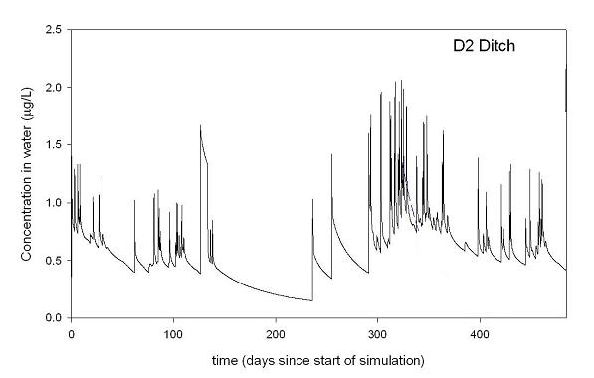
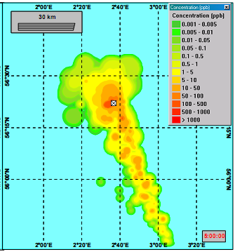
Fate modelling
pesticide fate modelling
oil-spill modelling

Slide 70
Classic ecotox
??
NOEC
EC50
prediction effects in dynamic environment
effects data over time for one (or few) set(s) of conditions
summary statistics

Slide 71
Learn from fate modelling
proper measures of toxicity
that do not depend on time or conditions
mechanistic
model for
species
prediction effects in dynamic environment
effects data over time for one (or few) set(s) of conditions

Slide 72
Data analysis
test conditions
model parameters for toxicant
mechanistic
model for
species
model parameters for species
effects data over time for one (or few) set(s) of conditions
model parameters that do not depend on time or conditions

Slide 73
Educated predictions
dynamic environment: exposure and conditions
model parameters for toxicant
mechanistic
model for
species
model parameters for species
prediction life-history traits over time
model parameters that do not depend on time or conditions

Slide 74
TKTD modelling
toxicodynamics
external
concentration
(in time)
toxico-kinetic
model
internal
concentration
in time
process model
for the organism
effects on
endpoints
in time
toxicokinetics

Slide 75
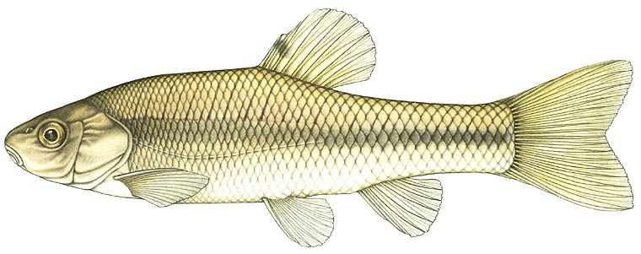
TKTD modelling
external
concentration
(in time)
toxico-kinetic
model
internal
concentration
in time
toxicokinetics

Slide 76
TKTD modelling
toxicodynamics
internal
concentration
in time
process model
for the organism
effects on
endpoints
in time

Slide 77
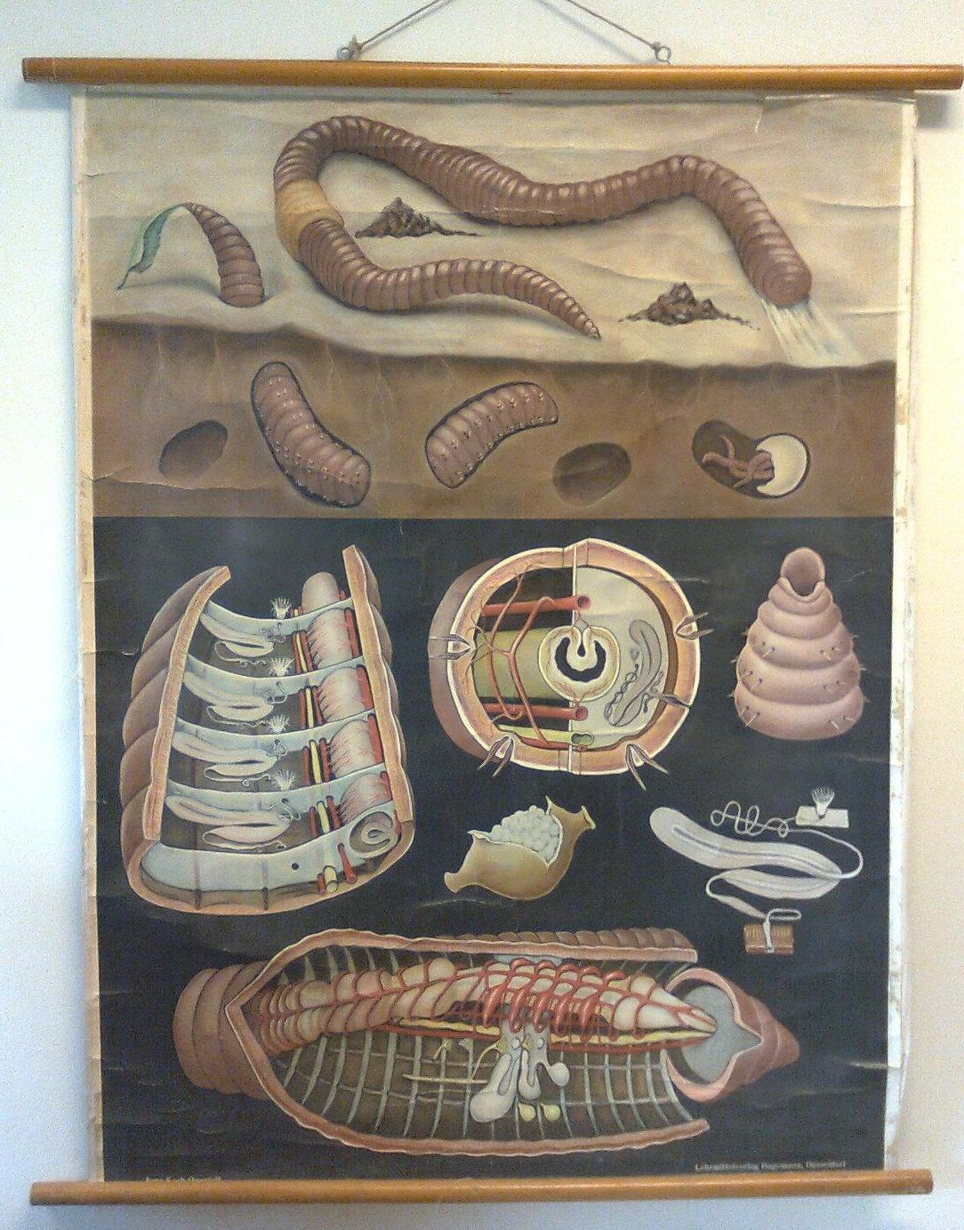
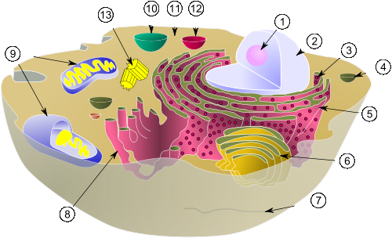

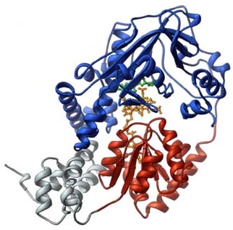
Organisms are complex …
process model
for the organism

Slide 78
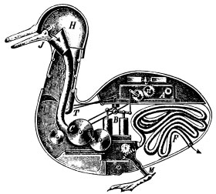
Learn from fate modellers
Make an idealisation of the system
how much biological detail do we minimally need …
  to explain how organisms die, grow, develop and reproduce
  to explain effects of stressors on life-history traits over time
  to predict effects for untested (dynamic) situations
  without being species- or stressor-specific

Slide 79

Learn from fate modellers
A process model can be extremely simple!
Acute survival
  short-term test with juveniles
  animals are not fed, so do not grow or reproduce
  death can be represented as a chance process
see ‘GUTS’ Jager et al. (2011)

Slide 80
‘DEBtox’ survival model
Assumptions
  effect depends on internal concentration
  chemical increases probability to die
1 comp.
kinetics
killing rate
hazard rate
NEC
hazard rate
blank value
internal concentration
internal concentration
survival in time
Bedaux and Kooijman (1994), Jager et al. (2011)

Slide 81

Example nonylphenol
1
0.004 mg/L
0.9
0.032 mg/L
0.056 mg/L
0.8
0.1 mg/L
0.7
0.18 mg/L
0.32 mg/L
0.6
0.56 mg/L
fraction surviving
0.5
0.4
0.3
0.2
0.1
0
0
10
20
30
40
50
time (hr)

Slide 82
Results
Parameters
  elimination rate 0.057 (0.026-0.14) 1/hr
  NEC 0.14 (0.093-0.17) mg/L
  killing rate 0.66 (0.31-1.7) L/mg/d
Parameters are
time-independent
comparable between species, chemicals, life stages, etc.
 | LC50 | s.d. tolerance
24 hours | 0.370 | 0.306
48 hours | 0.226 | 0.267

Slide 83
Learn from fate modellers
How do we deal with growth and reproduction?
These are not outcome of chance processes …
Organisms obey mass and energy conservation!

Slide 84

Mass & energy conservation
Notes:
Now we turn to the sub-lethal effects, and try to answer the question: how is reproduction affected by a toxicant? When we observe that a toxicant decreases the number of offspring, we should not start with questions about the significance of the effect, or estimate an ECx, we first have to ask WHY!
Offspring are not made out of thin air; the organism has to feed to produce juveniles. So when less resources are used for offspring, the reason could be that the toxicant is decreasing the feeding rate.
---------------------------------------------------------------------------------------------------
It is also possible that the feeding rate is still the same, but that the organism needs resources to detoxify the chemical, or to repair damage, and that less resources are available to reproduce.
---------------------------------------------------------------------------------------------------
And it is also possible that the investment in juveniles is the same, but that the toxicant kills the developing embryos.

Slide 85
Mass & energy conservation

Slide 86
Mass & energy conservation
Notes:
Now we turn to the sub-lethal effects, and try to answer the question: how is reproduction affected by a toxicant? When we observe that a toxicant decreases the number of offspring, we should not start with questions about the significance of the effect, or estimate an ECx, we first have to ask WHY!
Offspring are not made out of thin air; the organism has to feed to produce juveniles. So when less resources are used for offspring, the reason could be that the toxicant is decreasing the feeding rate.
---------------------------------------------------------------------------------------------------
It is also possible that the feeding rate is still the same, but that the organism needs resources to detoxify the chemical, or to repair damage, and that less resources are available to reproduce.
---------------------------------------------------------------------------------------------------
And it is also possible that the investment in juveniles is the same, but that the toxicant kills the developing embryos.

Slide 87
Mass & energy conservation

Slide 88
Mass & energy conservation

Slide 89
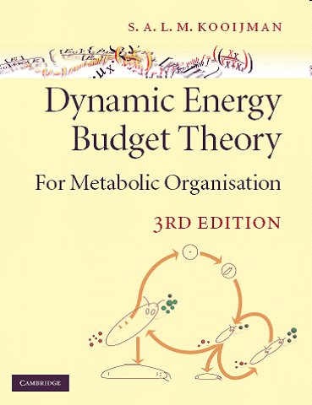
Dynamic Energy Budget
Organisms obey mass and energy conservation
  find the simplest set of rules ...
  over the entire life cycle ...
  for all organisms (related species follow related rules)
  most appropriate DEB model depends on species and question
Kooijman (2010)

Slide 90
DEBtox basics
Assumptions
  - effect depends on internal concentration
  - chemical changes parameter in DEB model
toxicokinetics
DEB
growth and repro in time

Slide 91
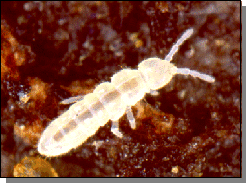
Ex.1: maintenance costs
TPT
body length
cumulative offspring
time
time
Jager et al. (2004)

Slide 92

Ex.2: growth costs
Pentachlorobenzene
body length
cumulative offspring
time
time
Alda Álvarez et al. (2006)

Slide 93
Ex.3: egg costs
Chlorpyrifos
body length
cumulative offspring
time
time
Jager et al. (2007)

Slide 94
‘Standard’ tests ...
model parameters for toxicant
mechanistic
model for
species A
model parameters for species
constant exposure, ad libitum food
Many DEBtox examples, see: http://www.debtox.info

Slide 95
Wrapping up
Time is of the essence!
  an organism is a dynamic system …
  in a dynamic environment …
  with dynamic exposure to chemicals
NOEC, EC50 etc. are pretty useless …
  for predicting effects in the field
  for comparing toxicity
  for helping us to understand toxic effects

Slide 96
Wrapping up
Mechanistic models are essential
  to extract time-independent parameters from data
  to extrapolate to untested dynamic conditions
  to increase efficiency of risk assessment
To do that ...
  learn from fate and toxicokinetics modellers …
  but ... more research is needed!
  and … more communication …

Slide 97
Wrapping up
Advantages of using energy budget as basis
  not species- or chemical-specific
  there is well-tested theory for individuals
  mechanistic, dynamic, yet (relatively) simple
  deals with the entire life cycle

Slide 98
More information
on DEB: http://www.bio.vu.nl/thb
on DEBtox: http://www.debtox.info
time is of the essence!

